Slide 1
Management Evaluation Review Findings Training
09/26/24

Slide 2
Objectives
Management Evaluation Review
Tools Used and Elements Reviewed
Setting a filing date
Ways to apply
Active Case Errors
CAPER Errors
Overall Summary

Slide 3
Management Evaluation Review
The State of Wisconsin conducts Management Evaluation (ME) reviews to evaluate the administration of the FoodShare (FS) program, federally known as the Supplemental Nutrition Assistance Program (SNAP).
The objectives of the MER are to:
Provide a systematic method of monitoring and assessing FS program administration in the project areas;
Provide a basis for project areas to improve and strengthen program operations by identifying and correcting deficiencies; and
Provide a continuing flow of information between Income Maintenance (IM) agencies, state agencies, and Food and Nutrition Services (FNS), necessary to develop the solutions to problems in program policy and procedures.
The target areas for fiscal year 2023 are:
Certification Processes and Program Access
Annual Mandatory Training
Unwinding of Covid-19 Policy Waivers
Able-Bodied Adults Without Dependents Time Limit and Work Requirement

Slide 4
Tools Used and Elements Reviewed
The ME Review activities consists of observation and analyzation of agency functionality and case accuracy
Tools used and elements reviewed may include
Active and Case and Procedural Error (CAPER) rates
Review of Error Letters
Certification Case File Reviews
Anonymous Calls and Customer Call Reviews
Lobby Observation and Agency Website Review
Annual Mandatory Training records
Customer, Advocate, and Staff Surveys
Permanent EBT Logs

Slide 5
Setting a Filing Date
Workers must encourage applicants to file an application or set a filing date on the same day that the applicant contacts the agency
For FoodShare, this is the date that benefits will begin, if approved. For Healthcare, benefits will go back to the first of the month
An applicant must provide only their name, address and signature to set a filing date
Below is an example of how to offer to set the filing date:
“In order to apply for benefits a filing date needs to be set which will determine the date that your benefits would begin. I can assist you with that over the phone right now. If you do not have time right now you can call back when you do have time, I can mail you an application, you can pick one up at your local agency or you can start the process online at access.wi.gov. You can also do the application in-person if you prefer.

Slide 6
Ways to Apply
Applicants must be offered all of the ways to apply which include:
ACCESS https://access.wisconsin.gov/access/
Phone (Telephonic signature)
In-Person
By Mail

Slide 7
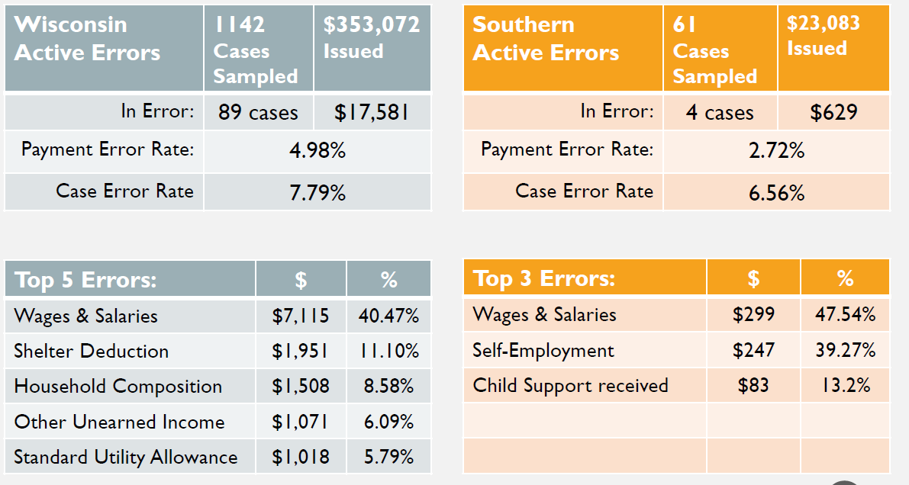
Active Case Errors
Active Error Data: Oct 2022-Sep 2023
Active Error Rate is based on the benefits issued which is reviewed and determined if there is a dollar amount error within the eligibility payment determination. The top three errors for Southern for 2023 were in the wages and salaries, self-employment, and Child Support received.

Slide 8
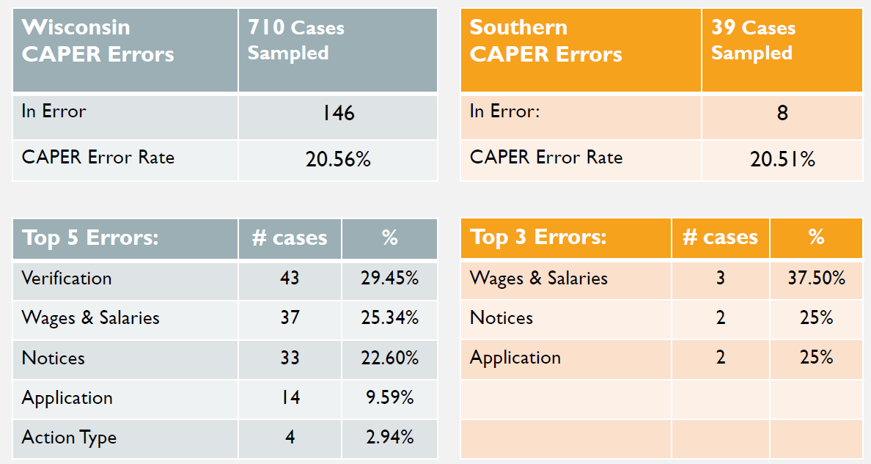
Case and Procedural (CAPER) Data Oct 2022-Sep 2023
Southern had 39 cases selected. A total of 8 cases were in error. Our CAPER error rate was 20.51 which is down from 34.09% a year ago.
CASE and Procedural Error Rate (CAPER) is a quality control system that measures the accuracy of state eligibility and benefit determinations for the Supplemental Nutrition Assistance Program (SNAP). The error rate for Southern 2023 was based on verification, wages & salaries, and notices errors.

Slide 9
Recommended Actions
Check the FS Budget and Assistance Group pages before confirming
Preview notices in CWW whenever possible
Suggested Trainings:
All COVID Unwinding courses, including micro-learning courses
IM Refresher: Active Error Rates
IM Refresher: Case and Procedural Errors (CAPERS)
IM Refresher: Prospective Budgeting
IM Refresher: Effective Interview Skills and Case Comments

Slide 10
Overall Summary
Most staff feel that adequate time is allocated for completing training, however would like more time to review and understand Ops Memos.
Call Quality Reviews reflected very good customer service with excellent policy knowledge. High percentages of staff indicate they read the Reporting Requirements and Work Requirements scripts for all interviews as required by policy, but some reviews did not have reporting requirements read
Agency lobbies and websites are customer-friendly with helpful staff and resources available.
A very high percentage of customers feel they receive great service and are treated fairly and respectfully, and are satisfied with overall service, per the survey results and Local Agency Customer Feedback forms

Slide 11
Questions?

