Slide 1
Food Share Interview Refresher August 8, 2024

Slide 2
Covid Unwinding
Food share interviews were waived for applications filed on or after June 26,2023 for individuals meeting the waived interview criteria.
Food Share waived interview Process will end Aug 31, 2024, and all Food Share applications and renewals processed on or after Sept 1, 2024 will require an interview

Slide 3
Application and Renewal Processing Standards
Priority Service Applications:
IM workers must make at least two attempts to contact an applicant to complete the interview on the same or next business day the application is received.
Standard 30 day applications:
IM workers must make at least at least two attempts to contact the applicant to complete the interview on the same business day the application is received or by the end of the second business day.
Renewals:
On demand interviews must be offered fall all renewals when received. IM workers must make at least two attempts to contact a member to complete the interview on the same business day the renewal is received or by the end of the 5th business day following the day it was received.

Slide 4
Contact Attempts
Workers must make two attempts to contact the applicant and complete the interview
Workers must allow at least 15 minutes between the first attempt and the second attempt to contact the applicant or member.
For scheduled appointments, the worker must make two attempts to contact the applicant at the time of the scheduled interview. If that attempt is unsuccessful, the worker should make a second attempt 15 minutes after the first call. The worker should document the contacts in the FoodShare Contact Attempts panel. The workers should then run the case through the driver flow and pend for FS interview, which will generate the appropriate notices to the customer

Slide 5
Contact made on first attempt
If you reach the customer on your first attempt, and the applicant cannot complete the interview at that time, schedule the interview at an agreed upon date and time and send the scheduled interview notice. No other contact attempt is required as the contact meets the on-demand requirement.
If you reach the customer on your first attempt, and the applicant cannot complete the interview at that time, and an interview cannot be scheduled at an agreed upon date and time (because they do not want to schedule an appointment or they state they want to call back another time, the worker should pend for interview. This meets the on-demand requirement, and no additional contact attempt is needed.

Slide 6
Scheduling the Interview
Agencies must make every attempt to schedule interviews to ensure that an initial FoodShare eligibility determination can be completed within the 30-day processing time frame.
Agencies are required to schedule and provide written notice of an interview for an initial Food Share application. Notice of the interview must be in writing and mailed to the applicant unless the notice cannot be received by the applicant prior to the interview date.

Slide 7
Missed Interview
NOMI requirements must be met if the applicant or member misses the interview
If applicants miss a scheduled appointment and contact the agency to reschedule within the 30-day application processing period, the agency must schedule another interview or complete an on demand interview.
If you receive a call on SCC from a customer who missed their interview, the interview should be completed during the phone call. The customer should not be told they will receive a call back from the county worker who made the original attempt.

Slide 8
Contact Attempts Panel
Every time the worker tries to reach the household for an interview, the details of the contact attempt(s) must be recorded using the FS contact attempts panel. This includes both successful and unsuccessful attempts, as the contact attempts must be logged even when the customer is reached and the interview is completed. The contact attempts panel is used to track processing timeliness.
Comments entered on the FS Contact Attempts panel do not transfer into the main case comments. Because they do not transfer, it is important to get in the habit of reviewing the comments in the contact attempts panel as well as the case comments.

Slide 9
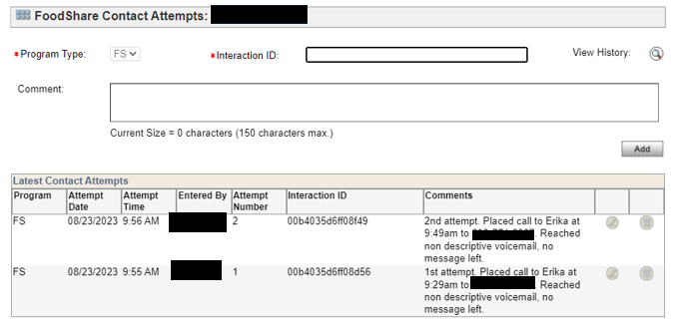
Contact attempts panel can be opened form the RFA Comments page or the Case Comments page in CWW​
CWW will display the ten most recent contact attempts for the case. ​
Contact attempts can be edited within the same day, but cannot be changed or deleted after that.

Slide 10
FoodShare Interview Reminders
Priority Service screens must be completed each time a new application is submitted for food share.
Each question with a red asterisk should be asked to the customer as they are written in CWW and not asked as a leading question.
Ask the questions and allow the customer to provide the answers to you, rather than asking the customer if the info on the screen is correct. For example: What is your current rent expense? VS You pay $900 per month in rent, right?
FDSH wages can be used only if the customer agrees they are accurate.
Workers should review the employment query screen for FDSH and if wages appear, workers are required to ask if they are accurate and reflective
Shelter and utility expenses must be reviewed and updated for new applications on closed cases and for renewals
SUE errors remain one of the top QC errors
Best efforts should be made to obtain actual estimates of SUE. Entering one dollar for unknown information is considered a technical error.
If a shelter or utility expense has ended, the screen must be end dated or they will continue to get the utility deduction in error.

Slide 11
Food Share Reminders
Appropriate Scripts must be read at the end of the interview
ABAWD/Work Registration Script (if triggered)
Reporting requirement script
ATS Interaction ID is needed in the telephonic signature screen to avoid mismatch.

Slide 12
Questions?

