Slide 1
BRITS Referrals -FEV and FRAUD
Rev. 5/23/24
Mary Donahue

Slide 2
Contents | Page
Definitions | 3
Error Prone Profile | 4
Logging in to BRITS | 6
Creating a BRITS Referral | 8
Searching for a Referral | 17
Invalidating a Program in BRITS | 19
Sending Referral Information to CSI | 22
Cost Avoidance | 23
Cost Avoidance Cheat Sheet | 27
Process at-a-Glance | 28

Slide 3
Definitions
BRITS stands for Benefit Recovery Investigation Tracking System. It is a stand-alone computer program. Access to BRITS is off the Gateway page.
Front End Verification (FEV) is the referral type used at intake, renewal or new program add. It gives the investigator a shorter timeframe to complete the investigation before initial benefits are issued. However, do not hold up benefit issuance waiting for the FEV findings. Follow 30-day processing rules.
Use FRAUD for investigations needed on ongoing cases.
Error Prone Profile -Cases that have one or more of the criteria on the next page meet Southern’ s error prone profile and require further investigation. This could be as simple as asking the customer about the situation (how are they meeting expenses with no income) or initiating a referral to CSI for a home visit to check things out.

Slide 4
Error Prone Profile

Slide 5
Error Prone Profile
Mandatory FEV Referral:
Mandatory FEV referrals policy must be followed. Mandatory referrals will be for investigations that require a home visit to verify household composition.
Things that can be verified via phone call (to client, employer, landlord, or another state) will be done by the agent.
If expenses exceed income, the agent will ask the customer how they are meeting their expenses with no income and document their answer in case comments.
If self-employment is suspected, but the customer denies having any, the agent will ask the customer to submit a written statement that they are not self-employed. This gives the agency a stronger case of intent for a future fraud case if SEI is later verified.
A worker in the county of residence is responsible for completing the cost avoidance form and emailing it to their agency’s Fraud Supervisor.

Slide 6
Logging In **You MUST use Chrome to log into BRITS**
Select BRITS from the CWW Gateway Page

Slide 7
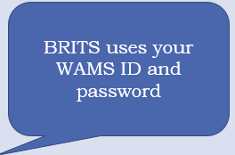
Logging In

Slide 8
Creating a referral

Slide 9
Creating a referral

Slide 10
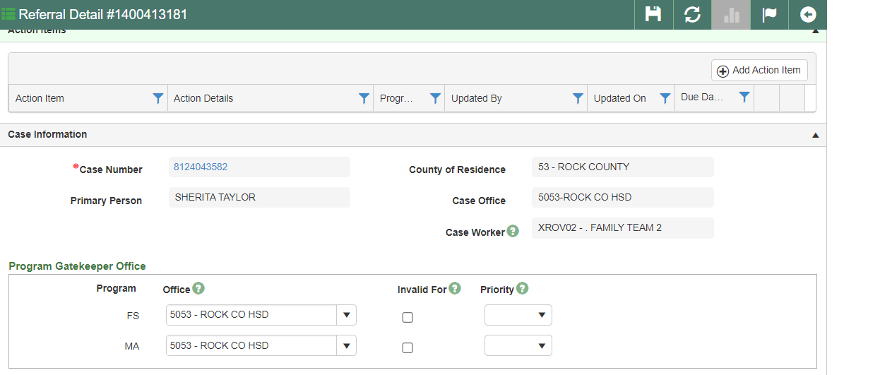
Creating a referral
This information
populates from CWW

Slide 11
Creating a referral
The programs populate in from CWW. The worker must assign each program an office code from the customer’s county of residence.

Slide 12
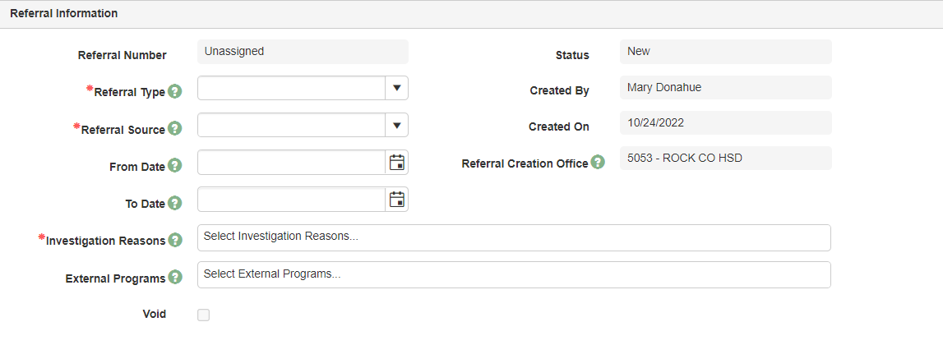
Creating a referral
Referral Type: Front End Verification (FEV), Fraud Investigation, Claim Investigation
Use FEV at intake, renewal or new program request. Do not hold up benefit issuance waiting for FEV findings. Follow 30- day processing rules.
Use FRAUD for ongoing cases
NEVER use Agency Error even if you are 1000% positive it’s agency error. Only the state can close out these referrals if created in error. We cannot change them locally.
Referral Source: Case Review, New Program, there is a full list in the drop-down menu
From and To Dates: Enter the date the issue to be investigated started and ended. CSI needs to know how far back they should investigate. If no date is provided, they will use the date of the referral.
External Programs: SLMB+, CTS

Slide 13
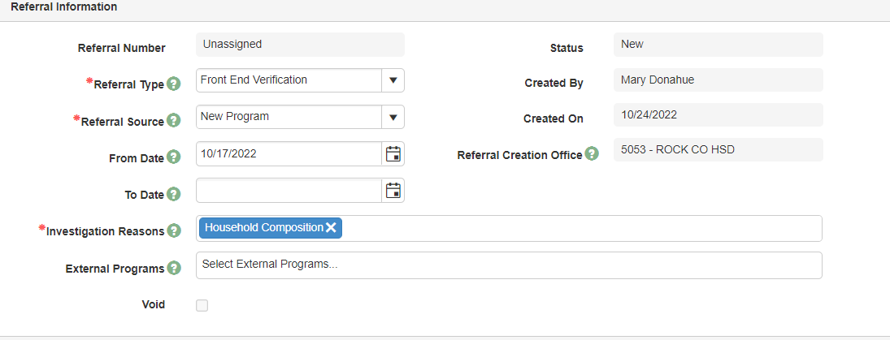
Creating a referral
Investigation reasons include:
Earned income, HHC, Child not in the home, etc. See drop down menu for all choices

Slide 14
Creating a referral
If you are in a CWW case, on the Case Summary screen, you can click the Create BRITS referral link to be directed to the BRITS referral page

Slide 15
Creating a referral
Enter detailed comments in the BRITS referral of exactly what you want investigated. These should be the same comments entered on the CSI referral form.
Click on Add Comment to enter comments. More comments can be added later too.
Make sure you save your comments before you leave the screen.

Slide 16
Saving a Referral
Click here to save information in BRITS
Click the floppy disk icon to save your referral.

Slide 17
Searching for a referral
Quick search field allows search by Referral, Case, PIN, or Claim number

Slide 18
Searching for a referral
Advanced Search allows searching by more detailed information

Slide 19
Invalidating in BRITS
A program can only be invalidated on certain types of referrals in BRITS.
For FEV/FRAUD referrals only a gatekeeper can invalidate programs. Please enter a note in your referral comments if you think a program should be invalidated and your County’s Gatekeeper will review it.
This is usually used to invalidate Child Care (CC) if it has been closed for awhile and was not open during the time frame you are investigating.

Slide 20
Invalidating in BRITS
BRITS auto-populates all programs recently open. A program may be invalidated if the investigation is not needed for it. For example, if Child Care has not been open for awhile, you can check the box next to it to invalidate it. That means the investigation does not pertain to the program. You must enter a comment in the referral as to why you invalidated it (e.g. CC invalidated as it closed 6/30/20).

Slide 21
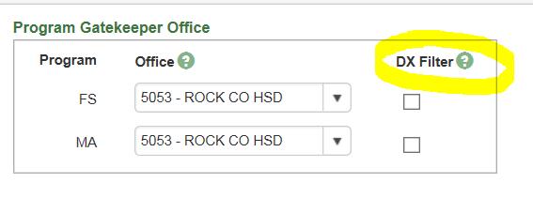
Invalidating in BRITS
Only Data Exchange (DX) and Additional Front End Verification (FEV) referrals have the ability to filter a program on a referral. The process for filtering marks the program as not active for this investigation. The Filtered function for a program area must be selected to filter a program.
The worker creating this type of referral has the ability to invalidate programs.
**Note it says DX Filter. That is different from the example on the previous page.

Slide 22
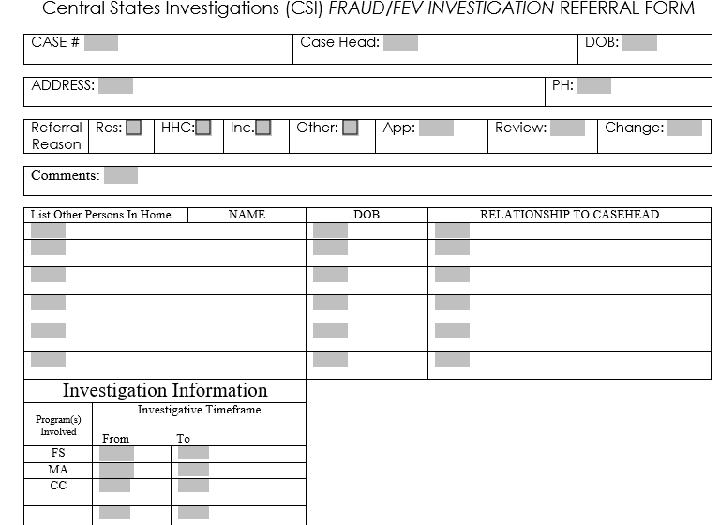
Referral to CSI
This is the top portion of the CSI referral form. BRITS does not contain all the information CSI needs to do an investigation. Once you complete their form, you can either upload it in BRITS under Add Document (at the bottom of the screen) or email it to fraud@csiagency.us

Slide 23
Cost avoidance
Cost avoidance is not an overpayment. It is an educated estimate of how much will be saved in future benefits due to the investigation findings. Cost avoidance information is what the state uses to determine how much money the fraud program is saving the state. Cost avoidance is a one month benefit amount. An overpayment is for the entire timeframe involved.
Cost avoidance amounts used for MA/BC+ are $200 per month per adult and $100 per month per child. Institutional savings are $3000 per month. FoodShare cost avoidance is the actual amount issued.
Who Does the Overpayment?
The county of the customer’s residence does any overpayments discovered as a result of the investigation. The need for an overpayment must be included on the cost avoidance form submitted to the Fraud Supervisor. The overpayment time frame and programs overpaid must also be on the form. The referring worker needs to request all necessary verifications needed to complete the overpayment.

Slide 24
Cost avoidance
This is the top portion of the cost avoidance form. Complete the form and email it to your county’s fraud supervisor.

Slide 25
Cost avoidance examples
Examples assume today’s date as 12/11/23
1. You refer a case for investigation in BRITS because you got a fraud tip that a customer is living in another state. The person applied in Wisconsin on October 1, 2023 and is receiving $291 per month. The investigation findings state the person is living in another state, never moved to WI, and FS should never have opened in WI. The one month cost avoidance is FS $291. An overpayment is needed for FS from 10/1/23—12/31/23. There is intent for fraud, so that needs to be indicated on the cost avoidance form as well.
2. Client just reported on her SMRF on 10/5/23 that the employed full-time, father of her 3 children, moved out. The total amount of November FS, without him and his income in the home, is going to be $766. The investigation findings show he really is gone. There is no cost avoidance.
However, if the investigation findings found him still living in the home, there would be cost avoidance. If the FS for the 5 of them is usually $160, and you would have issued $766, the cost avoidance is the difference of $606.
There is no overpayment as we’re pretending this all took place before October cutoff, but if the $766 in FS had actually been issued, you’d ask for an overpayment for November FS and indicate there is a potential fraud.

Slide 26
Cost avoidance examples con’t
According to the out of state usage report, a client has been using their FS in Alabama for the past 3 months, November -January. The client has reduced reporting requirements and did not have to report the move, but you need to know if you should close the case. The investigation findings show that the client moved back to Alabama in November and you close the case. The cost avoidance is the one month benefit of $291. There is no overpayment due to the reduced reporting requirements.
New application for FS and BC. Customer is not employed and claims to have his 2 children living with him. This seems suspicious as they are not school age, and have been with the mother in another state until now. He says she doesn’t want to care for them anymore and she is not on assistance in the other state. The total benefits, if you approve the application, would be FS for 3 of $766, MAGA of $200 and MAGC of $100 x 2 children = $200. The investigation findings indicate he does not have his children living with him. You open the case for FS and MAGS just for him. There is cost avoidance as the investigation findings prevented you from opening the case for a group of 3. The one month amount for the cost avoidance is $475 for FS (the incorrect allotment for a group of 3 of $766 minus the correct allotment for a group of 1 of $291) and $200 for BC+ (MAGC for 2 kids x $100). Since you did not issue incorrect benefits, there is no overpayment.

Slide 27
Cost avoidance cheat sheet
Determine amount of cost avoidance (what amount of benefits were saved for the next month based on the investigation). If there was no change to the benefits, indicate no cost avoidance found.
Based on the client’s reporting requirements, per prior notice of decision, was it something they even had to report? If not, there is no overpayment. If yes, the overpayment timeframe and programs affected is needed.
Example: Earned income fraud tip substantiated by CSI. Worker added the EI and ran eligibility. It appeared the case was only open for MA. Upon checking the FS issuance history, the worker found that the FS had ended 2/2024. Based on reporting rules, the customer was required to report the job by 10/10/23. A FoodShare overpayment may be needed.
Is the overpayment due to fraud? Is there intent for the overpayment (e.g. withheld or provided misleading information at intake, renewal or SMRF).
Example: Referred for overpayment claim for not reporting EI timely, but customer had a SMRF or renewal after they started the job and never reported the earned income. This shows intent for fraud as well as needing an overpayment.

Slide 28
Process at-a-Glance
Create BRITS referral and complete CSI referral form.
County of residence Fraud Supervisor will assign the BRITS referral for investigation.
Once the investigation findings are returned, the cost avoidance will be handled by the customer’s county of residence office.
Complete the Cost Avoidance form and email it to your County’s Fraud Supervisor for entry into BRITS.

Slide 29
Final reminder on referral types
Use FEV (Front-end verification) at intake, renewal or new program request. Do not hold up benefit issuance waiting for FEV findings. Follow 30-day processing rules.
Use FRAUD for investigations needed on ongoing cases.

