Slide 1
Overpayment training
OVERPAYMENT TRAINING
Presented by Mary Donahue, Laura Middleton and Adam Voss
03/28/24

Slide 2
Table of Contents
Definition and Types of Overpayments 3
Pandemic Processes Still Being Followed 6
Finding Existing Overpayments in Mainframe and BRITS 7
Notices 11
Returned Mail 18
Date of Discovery 20
Lookback Period 21
Minimum Threshold 23
Creating a referral in BRITS 27
Liable Individuals 30
Overpayment Processing—Mainframe and BRITS 32
MA Overpayment Tips 48
How to Enter a FS IPV 49
PACS 17
Duplicate Benefits 24
Case Comments 47
Extensions to Existing Overpayment Referrals in BRITS 51
BRITS Comments 25
FEV Referrals 30
FoodShare Compromise 52

Slide 3
Definition of an overpayment
An overpayment of benefits occurs if a member receives benefits they were not entitled to or more benefits than they were entitled to.
FoodShare and health care programs have very specific nonfinancial and financial eligibility criteria. An assistance group is either eligible or not eligible.
If an individual received benefits but it is later discovered that s/he did not meet the eligibility criteria, an overpayment may exist.
Workers must review cases thoroughly to determine if an overpayment has occurred.
Effective 04/1/23, DHS and the IM agency will no longer establish new BadgerCare Plus overpayment claims for members. CTS overpayments are still allowed to be requested.

Slide 4
Types of Overpayments
There are three types of overpayments: Non-client error, Client error and Intentional Program Violation (IPV).
Non-Client error occurs when a worker keys the wrong information, fails to act on available information, misapplies policy or the system gave the customer more benefits than s/he was entitled to receive.
Client error occurs when a customer unintentionally omitted or provided erroneous facts and received more benefits than s/he was entitled to receive.
Intentional Program Violation (IPV) occurs when a customer intentionally omitted or provided erroneous facts to receive more benefits than s/he was entitled to, and the individual was found guilty of the IPV by a court or an administrative disqualification hearing OR by signing a Disqualification Consent Agreement Form.

Slide 5
Overpayments cont’d
Child Care overpayments are required to be recovered—even if they are due to agency error.
Food Share errors are required to be recovered for agency and client error.
If the overpayment was based on the average quarterly SWICA wages, the client should be encouraged to send in their pay stubs or payroll printout for recalculation using actual income….this could reduce or eliminate the overpayment amount. If you are working on documents and come across these, please email the overpayment worker in the county of residence. The overpayment paperwork can be found in ECF.

Slide 6
Pandemic Processes still being followed
No Health Care overpayments are being processed 03/2020--current. ***CTS does not fall under MA overpayment rules so, we can process CTS overpayments.
No Child Care overpayments can be processed for the periods 03/2020--06/2020 and 03/2021--06/2021 unless they are due to IPV or zero-attendance hours in that month.
If a client would have been eligible for at least $1.00 in FoodShare, no overpayment is created during the Public Health Emergency timeframe, 03/20—05/11/23.
No recovery is allowed of the additional 15% FoodShare issued 01/21—09/21 or the additional $95 emergency supplement issued 04/21—02/24.
If more people were included in the household than should have been, then you can collect the difference between the FS maximum allotment amounts. Example: FS issued for group of 3 but should have been group of 2.
You may need to manipulate BVBD using PF24 or use the Overpayment Calculator Tool to adjust the claims as the system does not recognize that these amounts are not recoverable.

Slide 7
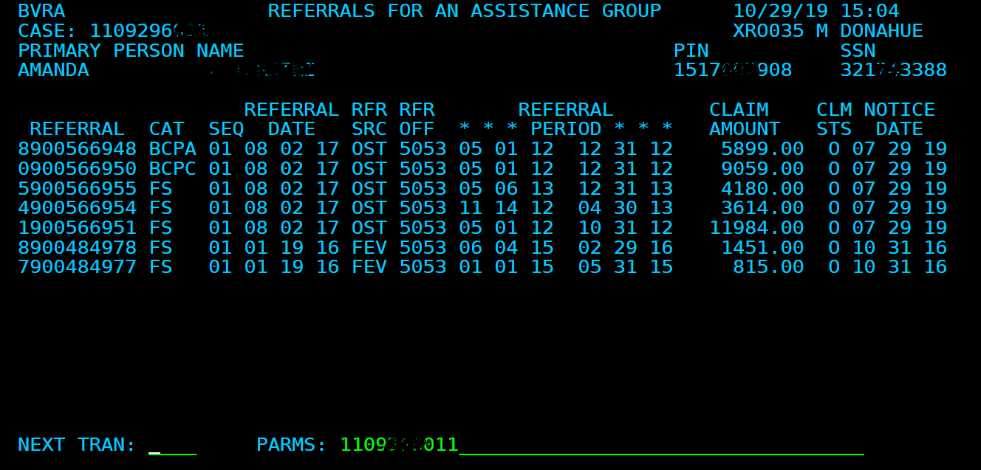
Finding Existing Overpayments on a CASE
To find a list of overpayments for a case, you can look it up in mainframe on TRAN: BVRA with PARMS: Case Number.
This list will show you the claim referral number(s), program type, referral period, claim amount and notice date.
Copies of all paperwork/manual notices should be in ECF, coded OP, under the corresponding case number.

Slide 8
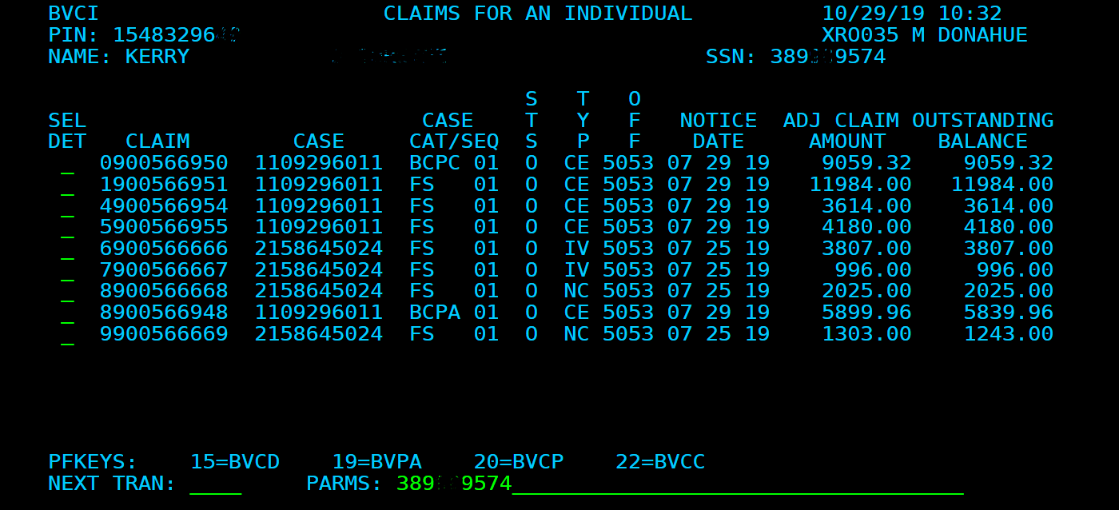
Finding EXISTING Overpayments for a PERSON
To find a list of overpayments by a person, you can look it up in mainframe on TRAN: BVCI with PARMS: SSN or PIN.
This list will show you which case(s) the overpayments go with, the original overpayment amount, and the current balance owed.
Copies of all paperwork/manual notices should be in ECF, coded OP, under the corresponding case number.

Slide 9
To see overpayment information Connected to a specific referral in BRITS
To see overpayment information in BRITS at the REFERRAL level, click the button circled in the screenshot below.
Clicking on the icon with the 3 bars found along the top of the screen will open the box shown below at the bottom of the screen. It shows the claim number, type, notice date, initial amount of the overpayment, and the current balance owed.
3/25/2024
9

Slide 10
To see ALL overpayment information Connected to a specific person—SEARCH USing PIN NUMBER

Slide 11
Overpayment notices Overpayment Notices are mailed out the next business day after the overpayment is entered. The arrow indicates where the OP timeframe and amount are listed.

Slide 12
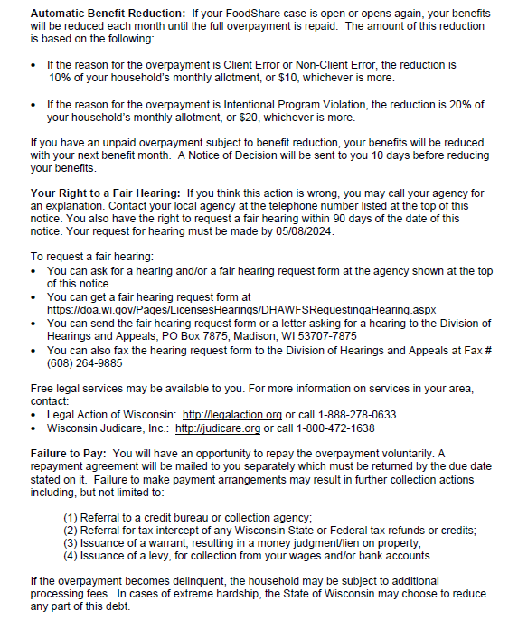
Overpayment notices cont’d
Overpayment notices include the deadline to file an appeal and the ways to request a fair hearing.

Slide 13
Repayment Agreement (RPA)
The Repayment Agreements mail out the first business day after the first of the following month (in case callers state they haven’t received this yet).
Example: If the overpayment is entered 10/3, the Overpayment notice will go out the next day 10/4. The Repayment Agreement will go out 11/4.
The RPA will not get mailed out at all if a Fair Hearing request is received prior to its mailing date. Once a fair hearing decision is made, the RPA will mail out if still needed.
***New versions of the RPA are set to go live in April 2024 to include information about the FoodShare Overpayment Compromise.

Slide 14
Sample RPA

Slide 15
Sample RPA cont’d

Slide 16
Sample RPA cont’d

Slide 17
Public Assistance Collection Unit (PACS)
Refer the client to the Public Assistance Collection Section (PACS) for ALL payment related issues such as payment arrangements, repayment agreement questions, late or missed payments.
The PACS phone number is
1-800-943-9499.

Slide 18
Returned Overpayment Documents
If the overpayment documents come back as returned mail with a forwarding address, re-mail the CWW-generated notices as well as the manual forms found in ECF. Document that you did so in case comments.
This information is important in the event the customer files for a Fair Hearing. If the remailed notices are not also returned, the customer will be assumed to have received them.

Slide 19
General Overpayment Reminders
When looking at notices to support an overpayment referral, be sure the notice reflects the correct program. A Health Care notice immediately before the overpayment period does not also make that the Food Share reporting limit.
If the notice refers to both FS and Healthcare (a combined notice), the income reporting limit listed is most often the one for Healthcare (not FS).
*The FS FPL for change reporting amount can be found on the Table of Income and Allotment Limits.
Be sure to check that the ongoing income is correct or add new employment, if found. Failure to do this results in an agency error. FS and ChildCare can recover agency errors, but an IPV cannot be obtained based on agency error.
Multiple claims may be created in BRITS for a case if the referral source is SWICA.

Slide 20
Date of Discovery Effective 12/01/21 OPS Memo 21-25 *This information does not apply to ChildCare overpayments.
The FoodShare program will define the date of discovery as “the date the worker creates the overpayment claim in the system and triggers notice to the member.”
If the requested information needed to confirm the amount of an overpayment is not returned or is incomplete, the best available information may be used.
This includes SWICA wage queries or other data exchanges.

Slide 21
Lookback Period Effective 12/01/21 OPS Memo 21-25 *This information does not apply to ChildCare overpayments.
The FoodShare look back period for client and non-client errors will be TWELVE months from the date of discovery.
The look back period will remain at SIX years preceding the date of discovery for duplicate benefits, FoodShare IPV, or trafficking claims.

Slide 22
Lookback Period Examples
Example 1: Sue applies for FoodShare and BadgerCare Plus on November 6 and is found eligible for both programs. On January 20, the IM worker discovers the earned income was miscalculated on Sue’s case. The IM worker correctly calculates the earned income and Sue is found ineligible for both FoodShare and BadgerCare Plus. The overpayment claim is created on the same date the case was corrected. The look back period for FoodShare, based on the date of discovery, is November through February. There is no overpayment for BadgerCare Plus because it was an agency error and agencies are no longer allowed to enter Health Care overpayments.
Example 2: Steve has been receiving FoodShare for the last 18 months. The IM Worker receives verification on November 5 that Steve falsified his information with the agency, and he has been a resident of Illinois the entire time. Steve is not receiving FoodShare in Illinois. The agency does not pursue an IPV. The worker enters the overpayment claim on November 6 and a notice is sent to the member. The overpayment is considered client error and the look back period is reduced to twelve months from the date of discovery, December through November. If the agency was granted an IPV, the overpayment lookback period would be the entire18 months.

Slide 23
Minimum Threshold Effective 12/01/21 OPS Memo 21-25 *This information does not apply to ChildCare overpayments.
Beginning December 1, 2021, the minimum threshold for each claim is $500 for client and non-client error FoodShare overpayments for both participating and non-participating food units.
If the overpaid amount is less than $500, no claim will be established unless it meets one of the following criteria:
· FoodShare IPV claims
· FoodShare overpayments discovered through a State Quality Control (QC) review
· Overpayments related to a member receiving duplicate benefits.

Slide 24
Duplicate Benefits
FoodShare
Duplicate benefits are defined as receiving benefits for the same month in more than one state or more than one case (except for those residing in a shelter for battered persons).
Healthcare
Duplicate benefits are defined as situations in which a member moved out of state, enrolled in another state’s Medicaid program, and received services under Wisconsin Medicaid more than two months after the move occurred.
TIP
It is very important to obtain verification from the state that issued the duplicate benefits, including the application date, benefit history for both programs, and the address on file if they are currently residing out of state.

Slide 25
BRITS comments format
Enter all this information into the BRITS comment section when you refer a claim for overpayment. You do not need to follow this format for FEV/FRAUD referral. On the next slide you will find three examples of information needed for an overpayment to be processed.
FRAUD?
PROGRAMS AFFECTED:
OP TIME FRAME:
NOD DATE AND $ LIMIT:
EI REQUESTED/RECEIVED?
COMMENTS

Slide 26
BRITS Comments examples
Example 1
FRAUD? NO
PROGRAMS AFFECTED: FS
OP TIME FRAME: 01/24—03/24
NOD DATE AND $ LIMIT: 11/27/23 $1580.00
EI REQUESTED/RECEIVED: Received—Work Number QPS, Not received—Impact Confections/Generac
COMMENTS: Client failed to timely report new employment at QPS, Generac and Impact Confections.
Example 2
FRAUD? Yes
PROGRAMS AFFECTED: FS
OP TIME FRAME: 7/21/21-12/31/23
NOD DATE AND $ LIMIT n/a
EI REQUESTED/RECEIVED? n/a
COMMENTS: Client applied for FS on 7/21/21 and stated she resided in WI and did not have an open case in any other state. Received Out of State usage report showing client has used all benefits in IL. Per IL DHS query, client also had open FS in IL when she applied in WI. Copy of IL benefit history in ECF.
*****If an IPV is done, you can recover the entire OP period. If you do not pursue an IPV, you can only recover benefits from the last 12 months.
Example 3
FRAUD? No
PROGRAMS AFFECTED: FS/MAGS
OP TIME FRAME: 5/23—8/31/23
NOD DATE AND $ LIMIT: 2/26/23 $1580.00
EI REQUESTED/RECEIVED? n/a
COMMENTS: Customer failed to timely report incarceration. Incarcerated 4/2/23-9/6/23
*****Incarceration is not required to be reported for FS except at renewal or SMRF, so there would be no overpayment unless an interview had been completed, and the incarceration was not reported.

Slide 27
Referring for Overpayment in BRITS
1) Log into BRITS. You must use Chrome to log into BRITS.
2) In the Create Referral section, enter the case# and then “tab”-- the primary person’s name, case office, county of residency and case worker will auto-populate.
3) Select the gatekeeper office for each program shown. This should be the client’s county of residence.

Slide 28
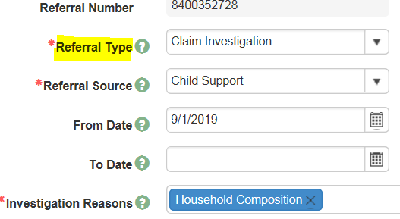
Referring for Overpayment in BRITS
4) Enter Claim Investigation as the Referral Type
5) Choose the Referral Source from the dropdown menu
NOTE: Multiple claims may be created for a case if the referral source is SWICA
6) Enter the From and To dates of the overpayment timeframe
7) Choose the investigation reason(s) from the dropdown menu
8) Enter comments—see slides 25 and 26

Slide 29
BRITS cont’d
9) To finish the BRITS referral click Save (the floppy disk image below with the red dot)
10) Each county assigns referrals based on their internal process
*****IMPORTANT REMINDERS ABOUT FEV REFERRALS!!
Enter a “From Date” so CSI knows how far back you need them to investigate. If no date is entered, they will only look at the current timeframe.
Enter case comments in CWW once the investigation findings are returned to document the findings. Make any corrections to the case as needed based on the investigation.

Slide 30
Liable Individuals (Ref: FSH 7.3.1.2 Liability)
All adult household members included in the group (or who should have been included) are liable for the repayment of total FoodShare overpayment amount. This includes adult children aged 18 and over.

Slide 31
Liable Individuals—Cont’d (Ref FSH 7.3.1.2 Liability, BCPH 28.4.3 Determining Liable Individual)
If someone was included in the household, but should not have been included, they are not liable. An example may be a household reporting a change in household composition (someone moving out) and the agency failing to remove the individual. The overpayment still exists, but the person who should have been removed would not be liable.
Liable individuals on a claim can be seen on CARES screen:
TRAN: BVCL and PARMS: Claim Number.
Overpayments follow liable individuals when they move to other cases.
Example: Fred and Wilma have a FS overpayment of $500. They are both liable individuals on the claim. Fred moves out of Wilma’s home and into Barney and Betty’s home. Fred is added to Barney’s FS. Fred’s liability to the overpayment on his case with Wilma will cause a recoupment out of Barney’s FS case.
Each liable person will be mailed a copy of the Overpayment Notice and Repayment Agreement (RPA). All liable individuals need to sign the RPA and return it to PACS. If you manually add a person to the claim, the system will not issue an Overpayment Notice. Manually send them a Notice of Food Share Overissuance form, F-16028.
***See page 40 for adding or removing a liable individual.

Slide 32
Overpayment Processing—CWW/Simulation
For FS, from the Case Summary Page, select the radial button for Initiate, Resume, or Terminate Simulation.
From the Simulation menu, select initiate simulation.

Slide 33
Overpayment Processing—CWw/simulation conT’D
Process for determining and calculating overpayment
For FS cases, use the actual income to determine if they exceeded the reporting requirements. Convert the income to determine any overpayment calculation. (FSH 7.3.2.1).
Example: Based on monthly income, the earnings went over report limits in 06/23 and required report by 07/10/23. The overpayment begins with 08/23. Use the converted 07/23 wages to determine the overpayment.
Exclude any income that was not reported and not required to be reported during this period.
Run eligibility for the period of the overpayment. Note the following:
Only 12 months at a time are allowed when running eligibility.
There may be more than one period based on length of overpayment and renewals on the case.
****If there is a renewal month that falls in the overpayment period and makes simulation fail months incorrectly, you should use the Food Share Wisconsin Overpayment Calculator tool found in
Forms—F-16030.

Slide 34
Overpayment Processing CWW/simulation cont’d
Terminate simulation WITHOUT delete so the information is retained in CWW for the overpayment processing in CARES mainframe.

Slide 35
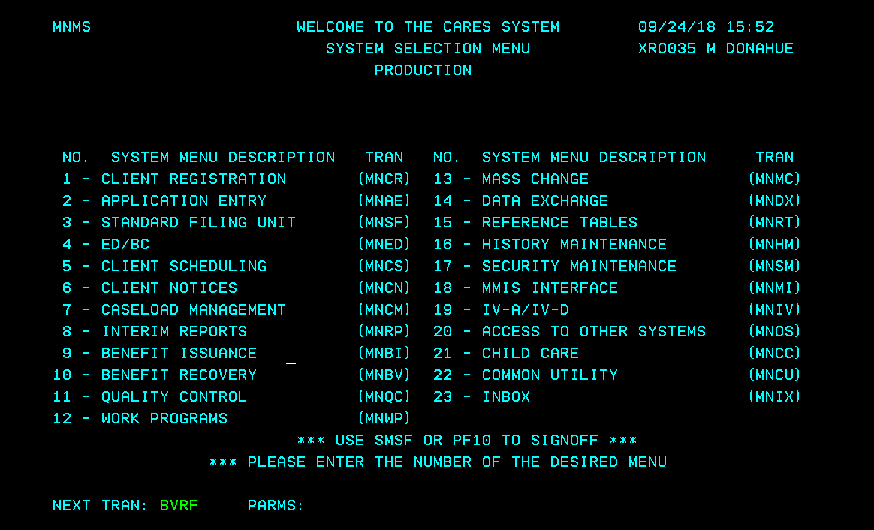
Overpayment Processing-Mainframe
1) Enter TRAN code BVRF with no PARMS and hit “Enter.”

Slide 36
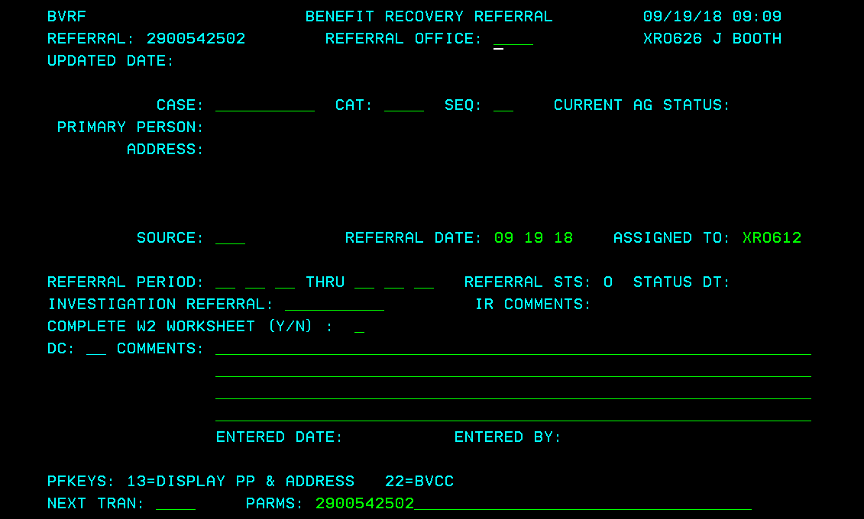
Overpayment Processing-Mainframe
2) This creates a new referral. The referral # displays at the top left corner of the page and in the PARMS. Write it down. If you forget to do this, you can find the claim number by going to TRAN code BVCI with the SSN or PIN.
X#####
2900xxxxxx

Slide 37
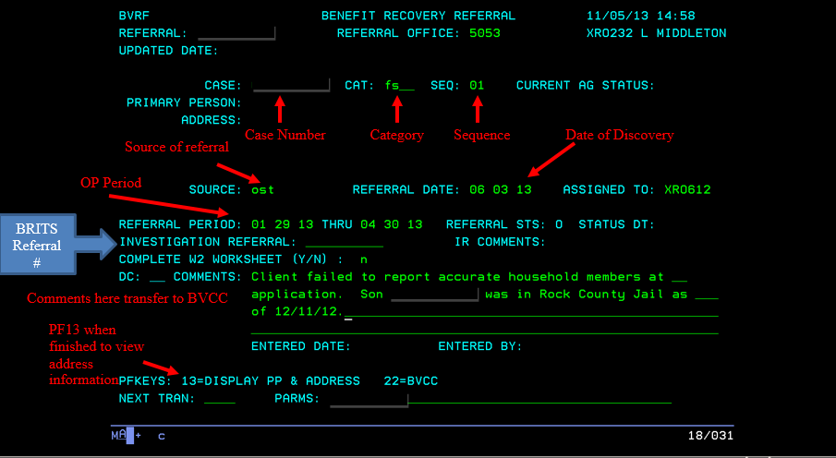
Overpayment Processing-Mainframe
3 )Enter the Referral Office, Case#, Category (CAT) and Sequence (SEQ)
4) Enter the source, assigned worker, referral date, referral period, and comments.
5) The investigation referral is the BRITS referral number. Note: The referral date is the date of discovery (the date the overpayment is entered into the benefit recovery system).
6) Press enter to create the referral. Comments from BVRF transfer to BVCC. TRAN to BVCC with the referral in PARMS to view or enter more comments.
X#####

Slide 38
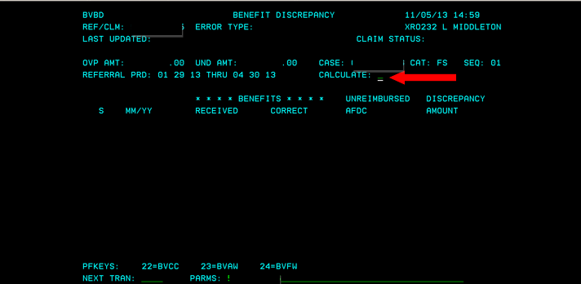
Calculating the Overpayment in Simulation
For FS only:
On the same day you run simulation, TRAN to BVBD, PARMS =Claim number
Enter “Y” in the “Calculate” field and press enter.

Slide 39
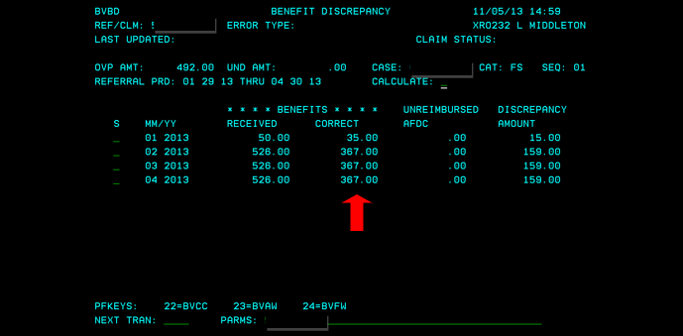
Overpayment Processing-Mainframe
CARES will pick up the correct benefits determined in simulation and compare them to the actual benefits issued. It then calculates and displays the total overpayment or underpayment amount. If the over/under payment amount does not seem correct, return to simulation and re-check your data. You may make changes in simulation, save them, and re-run the calculations in BVBD. If you want to see a budget, select the month and press PF24. You can make changes to any budget, if needed. If changes are made manually using PF24, select PF23 to save and exit. Go back to BVBD and make any other corrections that are needed.

Slide 40
Overpayment Processing- Mainframe cont’d
Tran to BVCL (Benefit Recovery Claim), PARMS =claim number.
The status is displayed. Enter the “Overpayment Reason” and “Error Type”. Codes can be found by entering “#” in the space.
Anyone over the age of 18 will be included as a liable individual on the claim.
BVCL will have the information regarding the overpayment period and original claim amount entered (FS only). If you used a manual FS worksheet, you need to enter the claim amount.
Remove anyone who should not be liable during the overpayment timeframe by putting a “D” in the DC field and enter a reason code. Place a # in the RSN field to display reasons.
If you need to add a liable individual to the claim, go back to BVCL and use PF21 to insert the liable individual using their PIN number. This cannot be done until the page has been fully created.
If you manually add a person to the claim, the system will not issue an Overpayment Notice. Manually send them a Notice of Food Share Overissuance form, F-16028.
See screen shot on next page.

Slide 41
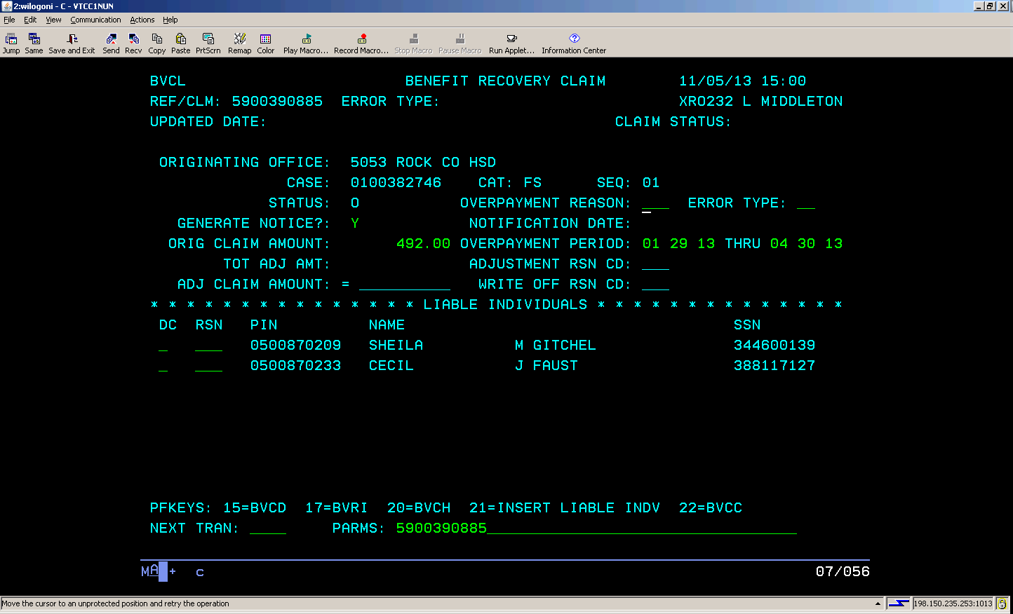
Overpayment Processing- Mainframe cont’d

Slide 42
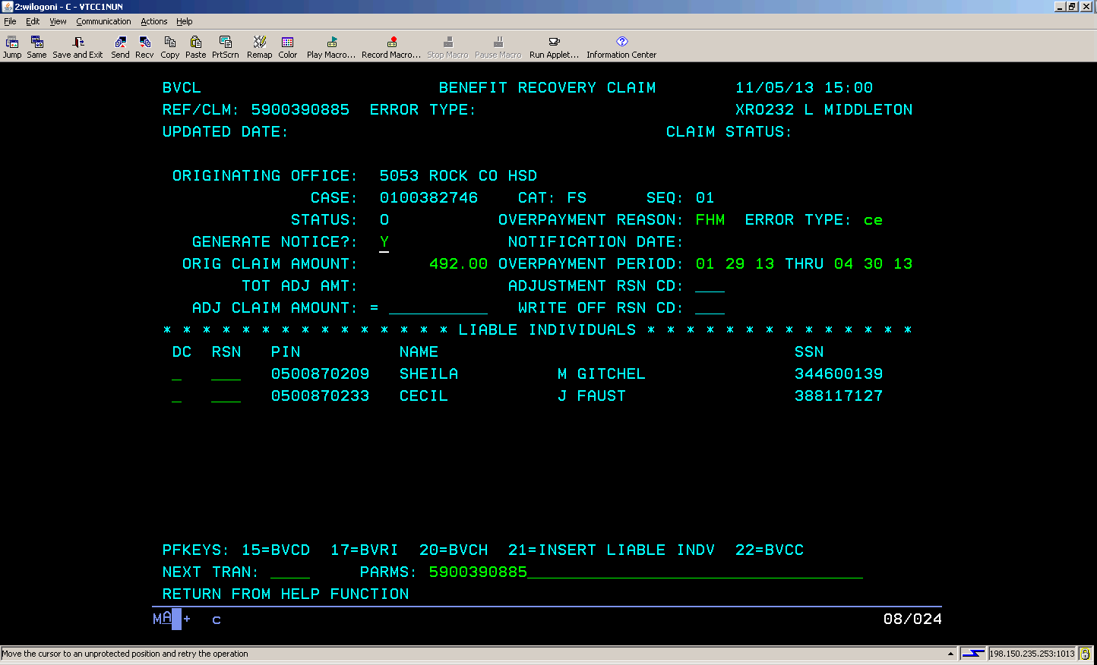
Overpayment Processing –Mainframe cont’d
Enter the Overpayment Reason and Error Type. Enter a # in the field to display options. Enter the FoodShare claim amount for claims that did not use BVBD.

Slide 43
Overpayment Processing--BRITS
***Reminder—Use Chrome!
Once you have completed all the needed claims in mainframe, go to BRITS to close the referral.
Type in the BRITS referral number in the top right side of the page and hit enter.

Slide 44
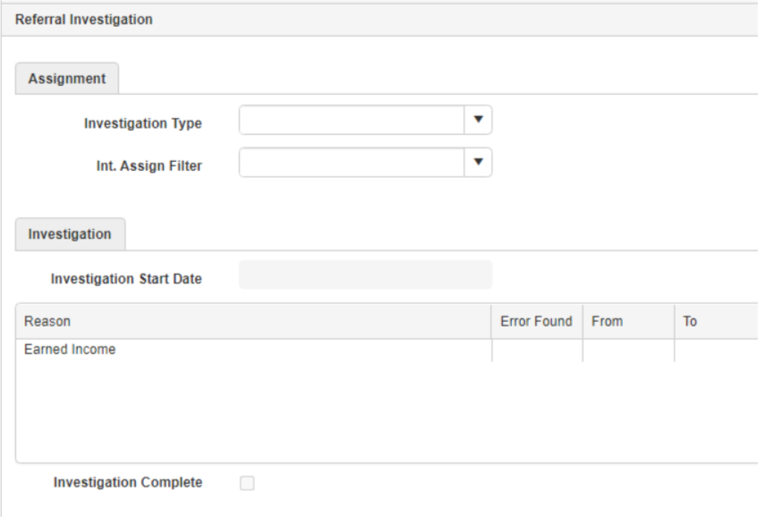
Overpayment Processing—BRITS cont’d
Counties each assign referrals and handle the investigation step differently. --If the referral has not already been assigned to you, in the Assignment section, fill in the Investigation type, Int. Assign Filter and assign it to yourself. --If it has not been already filled out, complete the Investigation section by entering the Investigation Start Date, updating the investigation findings section, and marking the Investigation Complete box.

Slide 45
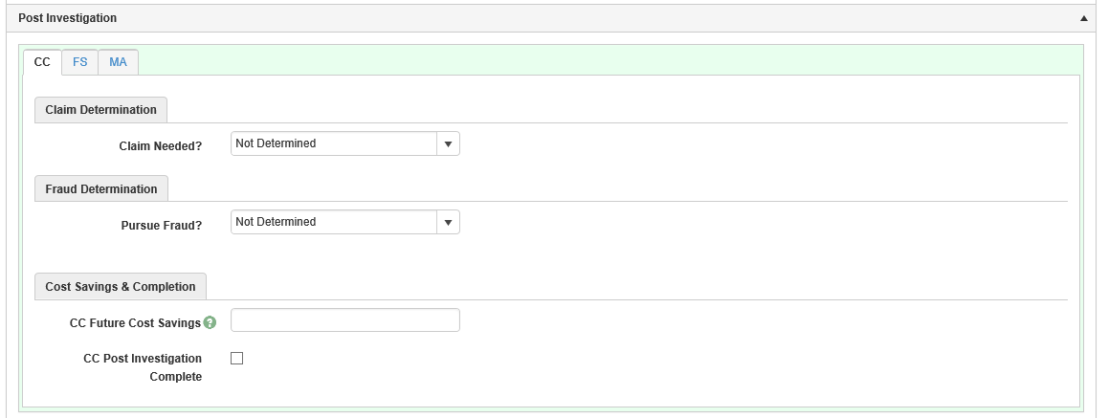
Overpayment Processing—BRITS cont’d
1. In the Post Investigation section, you will need to make entries for any pages that exist—FS/MA/CC. A W2 worker will usually close out their page. --If there is no claim needed, mark that there is no claim, no fraud, enter the appropriate cost savings, and mark the Post Investigation Complete box. Enter a comment to explain why there is no overpayment needed.
--Enter Program Invalid for categories that do not require a claim—example: MA. You cannot use the Invalid entry for the primary referral type. --If you do not fill in all the entries, BRITS will not allow you to close out the referral.

Slide 46
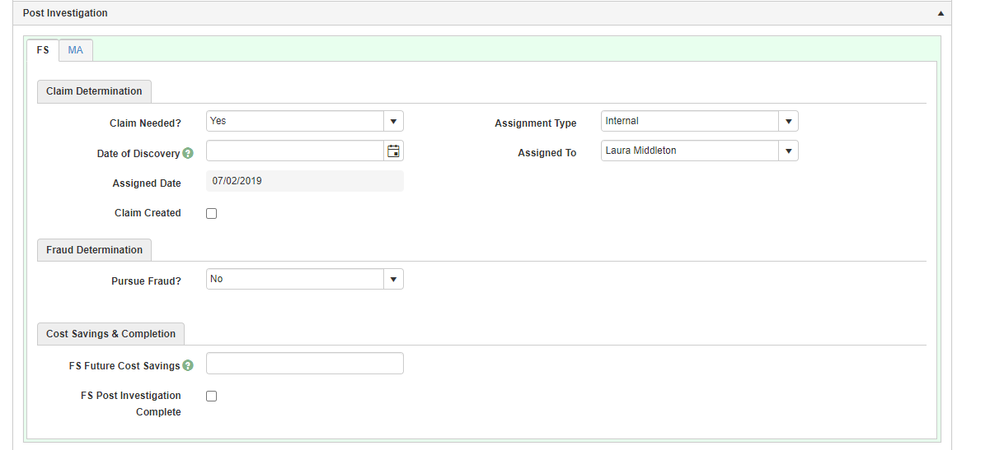
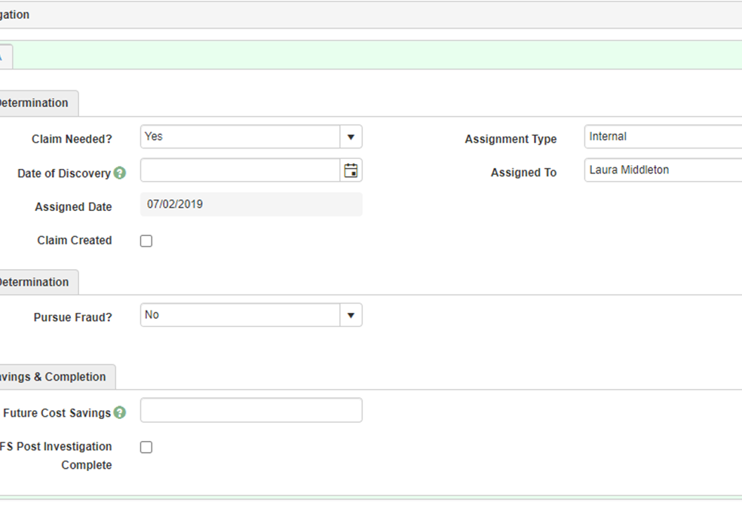
Overpayment Processing—BRITS Cont’d
2. Complete the necessary entries for Claim Needed, Date of Discovery (FS only), and the Assignment Type and Assigned To drop down boxes. Mark the claim complete box. ***Reminder: Date of Discovery is the date the overpayment was entered into mainframe. 3. Complete the entries for Fraud Determination and Cost Savings. 4. Mark the Post Investigation Complete box.

Slide 47
Case Comments
It is best practice to enter case comments in CWW when you enter an overpayment.
Include the claim type and number, overpayment period, and amount.
Document the reason the overpayment was entered. You can copy in the comments entered on BVRF.

Slide 48
MA Overpayment reminders
BC+/MA claims were calculated using the actual income. If no income verification was received, the average quarterly SWICA wages or other available data exchanges were used.
Most BC+/MA overpayments were calculated using the Forward Health Total Benefits Paid screen. The agency was required to recover the Net Paid Medicaid and Net Capitation payments. These amounts were added together to determine the amount overpaid.
As of 2019, MAGA adults who moved to MAGM had no premiums to pay, regardless of their income changes. However, the children may have still owed a premium.
It did not matter whether a customer ever used their medical card, they were still liable for the overpayment. This is because the State paid out an HMO premium for them to have the coverage.
Effective 04/01/23, agencies are no longer allowed to enter MA overpayments. PACS is in the process of closing all outstanding MA overpayments. They anticipate this will take a few years to complete. In the meantime, they are still collecting on the existing overpayments through client payments and tax intercepts. These payments will not be refunded to the client.
Net Paid Medicaid is the amount that the State paid out for services that the client actually received for prescriptions.
Net Capitation is the monthly HMO premium the State pays for the client to have the medical coverage each month.

Slide 49
How to enter a foodshare ipv
Go to BVCI with SSN to find the claim number(s) pertaining to the FS IPV.
1
Go to BVCL with each of the FS claims the IPV goes with. Change the ‘Error Type’ to IV for each claim.
2
In CWW, enter the case number. Under Individual Non-Financial, go to the FS IPV sanction screen.
3
Enter the Intentional Program Violation Number (1, 2, or 3).
Enter the Type of Offense Code as “F1” (F2, F3) to correspond with the sanction number.
4
Enter the Decision Date (the date the signed Disqualification Consent Agreement Form or court decision was received).
5
At the bottom of the page, click the box reading “Load List of BRITS Referrals”. A list of all BRITS referrals and claims will appear.
6
Check the box next to the BRITS#/FS claim(s) that go with this IPV. The error type must be Fraud to link the claim. Press Next.
7
Enter case comments, for example: An ADH decision of sustained received 02/13/24. FS IPV #1 keyed today eff. 03/1/24 for 12 months. Goes with FS claim 0900xxxxxx.
8
The Sanction Duration in Months and Sanction Begin Date will auto populate once you enter off the screen.
9
See next page for example.

Slide 50
CWW foodshare IPV sanction page

Slide 51
Extensions to Existing Overpayment Timeframes
If there is an open, uncompleted, claim referral in BRITS for a case, and continuation of the previously requested overpayment period is needed, please enter BRITS comments with the new overpayment period.
Request any additional verification needed for the extended timeframe.
For a Rock County case, email the overpayment team in Rock County at OverpaymentReferrals@co.rock.wi.us This is very important due to the new processing timelines.
Include in the email the case name, case number or BRITS referral number, date of the original BRITS referral and the extended overpayment period.
EXAMPLE: Barney Rubble, BRITS# 1234567890, original referral date 3/13/23, additional overpayment needed for the time frame of OP 8/23-10/23

Slide 52
Foodshare compromise request Process Help 31.3.8.1.1
A compromise is an agreement or a settlement of a dispute that is reached by each side making concessions.
*Liable individuals with a client error or non-client error FoodShare overpayment claim may request to compromise the amount owed.
*Overpayment claims due to an Intentional Program Violation (IPV), trafficking, duplicate participation, or fraud are not eligible to be compromised.
*Compromise requests must be submitted by a liable individual on the claim using the Overpayment Claims Compromise Request Form to the agency who created the original claim. If an agency receives a compromise request on a claim they have not established, it will be redirected to the agency that did establish the claim.
*The FoodShare Overpayment Claims Compromise (OCC) tool enables the Income Maintenance (IM) or Tribal IM workers to review and process overpayment claim compromise requests directly within CWW using the OCC tool. Correspondence, verifications, and calculations are automated through the OCC tool to aid workers in processing requests.

Slide 53
Creating a Foodshare overpayment compromise request
All workers and supervisors have access to the OCC (Overpayment Claims Compromise) tool and can initiate compromise requests. The OCC tool is accessed from the CWW navigation menu.
When a member contacts the agency to request a compromise of their claim, the worker must generate an OCC form. The system will mail it to the liable individuals.
1. Select Initiate Request to go to the Initiate Compromise Request page.
2. Collect the following details:
Agency information (County that created the claim, County of residence, Eligibility Office)
Member PIN number
***Important Note: If you have a person calling who resides in a different county than the one that entered the overpayment, follow the example below.
Example: Client resides in Jefferson County and the overpayment was completed in Green County, so the request page should be entered as:
County/Tribe: Green County
County of Residence: Jefferson County
Eligibility Office: Green County

Slide 54
Creating a foodshare overpayment compromise request, cont.
3. Click the NEXT button to start the compromise request and navigate to the Compromise Individual Demographics page.
Enter Member Contact Information: Email address, phone number, address
Authorized Representative Details (if applicable): name, communication preferences, address
4. Click NEXT to navigate to the Claim Compromise Address Verification page. The page schedules a driver flow to verify the address is accurate. If a liable individual is part of multiple cases, CWW will search FoodShare cases associated with the liable individual’s PIN and populate those case numbers in the individuals Information from CARES section.
5. The Representative Demographics page will schedule only if the question “Is there a verified representative for this liable individual?” is answered with a Yes.
6. On the Compromise Request Generation page, answer YES to the question “Has all information been collected to create a claim compromise request letter?” from the drop-down menu.
7. Click NEXT to generate the request form from the Compromise Generation Form page. The request form will go out during the nightly batch run.

Slide 55
Foodshare overpayment compromise request—things to remember
Each OCC Form includes a cover letter, instructions, and the request form. The form is PIN-based and is expected to be returned in a separate envelope by the liable individual. A member can only have one active Overpayment Claim Compromise Identifier Number (OCCIN) at a time.
This may generate phone calls as the form directs clients to contact the agency if they need assistance filling out Section 2—Overpayment Information.
Liable individuals will need to mail, or hand deliver their compromise request—there is no fax or document upload option for members to submit their form to the agency. The request form should be submitted to the IM agency that established the claim, however if an agency receives a compromise request on a claim they have not established, it will be redirected to the agency that did establish the claim.
Any verifications submitted must be mailed or dropped off at the listed agency. These documents cannot be faxed or submitted to the CDPU.

Slide 56
Foodshare overpayment compromise request—things to remember
See Process Help 31.3.8 for all steps of the compromise process.
Once a completed and signed compromise request form is received, the worker must attempt to evaluate requests within 30 days of receipt.
Verify that the 90-day FoodShare fair hearing window has elapsed, no fair hearing has been requested, and no fair hearing decision is pending. Deny the claim if the fair hearing window has not elapsed, a fair hearing has been requested, or a decision is pending.
If verification is needed to determine the compromise, navigate to the Claim Verification Document Request page.
All notices for the compromise process will be generated from the OCC tool.
If a compromise is approved, you will use the DCF Write-off/Adjustment Form to notify PACS that the request was approved, who it was approved for as well as the new claim amount. Workers are responsible for manually sending the downloaded form to PACS via email. A link to this form will appear on the Claim Compromise Details page. See the next slide.

Slide 57
Claim compromise details page

Slide 58
Questions?

