Slide 1
FoodShare Student Eligibility
03/14/24

Slide 2
Overview
What is Student Eligibility?
Enrollment Status
Institution of Higher Education-Definition
Student Eligibility for FoodShare
Student Eligibility in a Two-Year Program- Examples
CWW Processes
School Enrollment Page
Questions

Slide 3
What is Student Eligibility?
People enrolled half-time or more in an institution of higher education are ineligible for FS unless they meet an exemption
Students can be enrolled for in-person, online or hybrid courses
Customers 18-49 enrolled less than half time do not have to meet an exemption for FS
A student is considered enrolled as of the first day of the school term through normal scheduled class periods, vacation, and recess unless they
Graduate
Are suspended, expelled, or drop out
Don't intend to register for the next school term (excluding summer school)

Slide 4
Enrollment Status
For undergraduates, half-time enrollment is usually six credits (or two classes) and full-time enrollment is usually a minimum of twelve credits (or four classes)
For graduate students, full-time enrollment usually equals nine credits (or three classes)
Some schools use a quarter or trimester system and may have different credit thresholds
The college, university, or school can provide enrollment status for an applicant if it is unclear or questionable

Slide 5
Institution of Higher Education-Definition
An institution of higher education may be defined as:
A business, technical, trade, or vocational school that normally requires a high school diploma or equivalency certificate for enrollment in the curriculum –OR-
A regular curriculum at a college or university that offers degree programs regardless of whether a high school diploma is required

Slide 6
Student Eligibility for FoodShare FSHB 3.15.1
Exemptions:
Physically or mentally unfit for gainful employment. If questionable, verify through receipt of temporary or permanent disability benefits, or a statement from a physician or certified psychologist
Under age 18 or age 50 or over
Enrolled in Wisconsin Works (W-2) or other TANF-funded program under Title IV of the Social Security Act
Employed at least an average of 80 hours per month with earnings (this excludes in-kind income)
Compliance is determined by calculating whether the student worked an average of 80 hours per month over the period of a month, a quarter (calendar), a trimester (Fall, Winter, Spring), or a semester (Fall semester (1st) or Spring semester (2nd)). This is like budgeting for contractual and fluctuating employment (see SECTION 4.3.2 EARNED INCOME)
The payment can be received with regular frequency (that is, weekly, biweekly, semi-monthly) or as a one-time payment at the beginning or end of the employment period. There is no minimum wage or amount that must be received

Slide 7
Student Eligibility for FoodShare FSHB 3.15.1
Exemptions Continued:
Self-employed at least an average of 80 hours per month with self-employment earnings (after self-employment expenses are subtracted) equivalent to at least the federal minimum wage
Gross monthly earnings must be at least $580 per month ($7.25 x 80 hours)
Use student monthly hours to calculate a weekly average. Students whose employment hours fluctuate may be determined eligible for FoodShare, provided they maintain an average of 80 hours per month at minimum wage
Participating in a state- or federally-financed work study program during the regular school year (no minimum hourly requirement)
The student must be approved for work study at the time of FoodShare application or reported change, the work study must be approved for the school term, and the student must anticipate actually working at a work study placement during that time
The exemption shall begin with the month in which the school term begins, or the month work study is approved, whichever is later. Once begun, the exemption shall continue until the end of the month in which the school term ends, or it becomes known that the student has refused an assignment
The exemption shall not continue between terms when there is a break of a full month or longer unless the student is participating in work study during the break

Slide 8
Student Eligibility for FoodShare FSHB 3.15.1
Exemptions Continued:
Participating in a paid on-the-job training program. This exemption applies only during the period the person is being trained by the employer
Responsible for the care of a dependent food unit member under age six. If two people exercising parental control are in the food unit, apply the exemption to only one person per child
Responsible for the care of a dependent food unit member who has reached age six but is under age 12 if the agency determines adequate child care is unavailable to enable the student to attend class or work activities. If two people exercising parental control are in the food unit, apply the exemption to only one person per child
Single parents enrolled in an institution of higher education on a full-time basis, as determined by the institution, and are exercising care and control of a dependent food unit member under the age of 12
To apply this provision there must be only one biological or adoptive parent or stepparent in the same food unit as the child. If there is no biological or adoptive parent or stepparent living with the child, another full-time student living with the child may qualify as an eligible student under this provision if the student has parental control of the child and does not live with their spouse

Slide 9
Student Eligibility for FoodShare FSHB 3.15.1
Exemptions Continued:
Is assigned to or placed in an institution of higher education through or in compliance with the requirements of FSET, a program under the Job Training Partnership Act of 1974 (WIOA), or a program under section 236 of the Trade Act of 1974 (TAA)
Persons who voluntarily participate in one of these employment and training programs and are placed in an institution of higher education through or in compliance with the requirements of the program shall also qualify for the exemption
Is enrolled in a program at an institution of higher education that meets the definition of a technical and/or vocational studies as detailed within the Carl D. Perkins Career and Technical Education Act of 2006 (20 U.S.C. 2302). Additionally, the program must lead to a diploma, certificate, apprenticeship, journeyman, or associates degree. The program must be designed to be completed in two years or less, not including post certificate apprenticeship or training
All Wisconsin Technical College System WTCS programs, except for programs designed exclusively for transfer to a four-year program, qualify as Career and Technical Education
The WTCS classifies any person taking classes within their system as an enrolled student. To be considered for the technical and/or vocational studies exemption, they must be enrolled in a program leading to a diploma, certificate, apprenticeship, journeyman, or associates degree
Classes taken for personal development outside of an established program curriculum do not qualify for the technical or vocational studies exemption
A program at an institute of higher education limited to remedial courses, basic adult education, literacy, or English as a second language
Enrollment in certain employment and training programs for low-income households, which are operated by a state or local government and have an equivalent component to SNAP E&T (FSET)

Slide 10
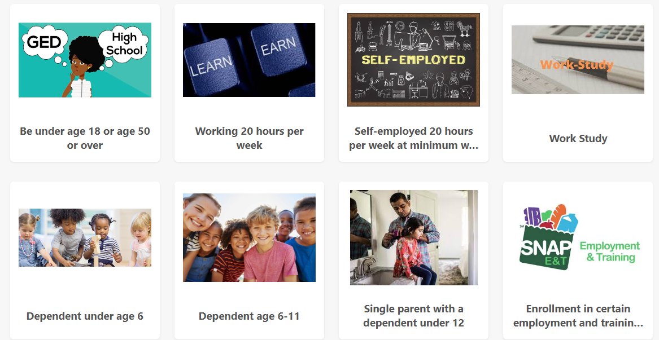

Slide 11
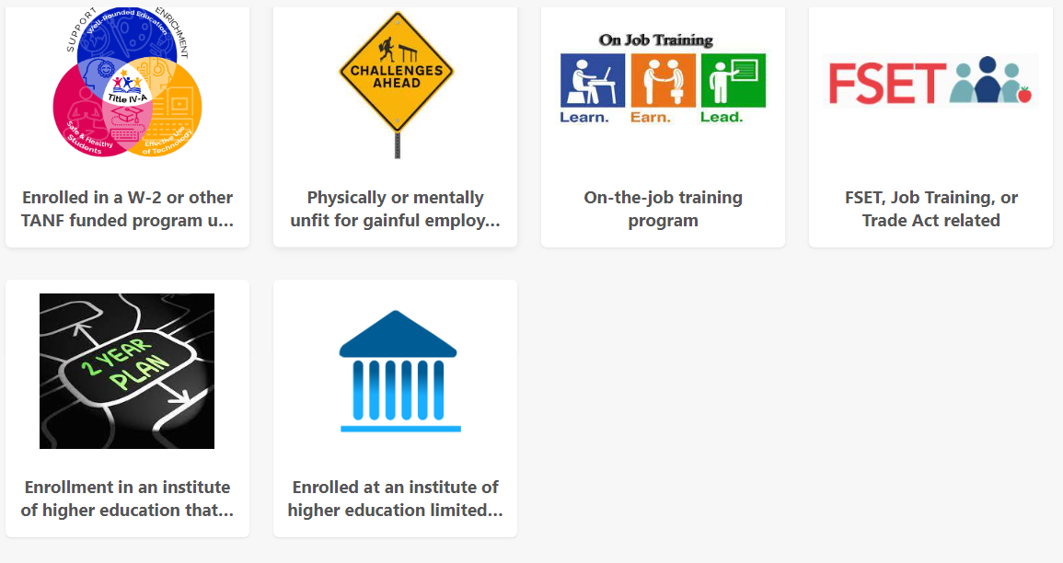

Slide 12
Student Eligibility in a Two-Year Program- Examples
Students enrolled in a two-year program that will lead to in-demand employment are eligible for FoodShare
Example 1: During an interview for FoodShare, Jack reports that he are a full-time student at Northern Technical College for phlebotomy and plans to graduate in the next year. Jack is enrolled in a two-year degree program that is expected to lead to a Phlebotomy Technician Technical Diploma. Jack meets all other eligibility criteria and is determined to be eligible for FoodShare because Jack is enrolled in a program at an institution of higher education that meets the definition of a technical or vocational studies as detailed within the Carl D. Perkins Career and Technical Education Act of 2006 (20 U.S.C. 2302)
Example 2: When Carla applies for FoodShare, Carla reports taking classes at Madison Area Technical College (MATC). Carla is taking cooking with herbs, pottery, and jewelry making. While Carla is enrolled and taking classes at MATC, Carla is not considered an enrolled student for FoodShare purposes because Carla is taking personal development classes, which are outside of the regular curriculum
Example 3: When Bill applies for FoodShare, Bill reports enrollment in a four-year nursing program at a state university and has two years left in the program. Bill does not meet any other student exemptions. Bill is not eligible for FoodShare

Slide 13
Student Eligibility in a Two-Year Program- Examples
Examples of course completion having a direct link to employment:
Note: this is not an exclusive list. Workers need to use critical thinking when determining what programs will lead to employment
Social and Human Service Assistants
Radiation Therapists
Veterinary Technologists and Technicians
Cardiovascular Technologist and Technicians
Radiologic Technicians
Dental Hygienists
Magnetic Resonance Imaging Technologists
Web Developers
Wind Turbine Service Technicians
Solar Photovoltaic installers
Occupational Therapy Assistants
Home Health and Personal Care Aids
Physical Therapy Assistants
Derrick Operators
Forest Fire Inspectors and Preventions Specialist
Massage Therapists
Respiratory Therapist
Medical Assistants
Phlebotomists
Diagnostic Medical Sonographers

Slide 14
Verification
Verification of student enrollment status is typically not required
Verification requests depend upon the type of exemption being reported and whether the information provided by the FS member is determined questionable by the agency
Verification of student eligibility exemption(s) is not required unless otherwise noted as a part of eligibility requirements or deemed questionable
Exemptions to the student eligibility policy are verified by using an enrollment letter, financial aid papers, letter from the school, or any other applicable document. IM workers should not require a specific type of verification

Slide 15
CWW Processes
CWW determines student eligibility exemptions based on number of hours worked per month and gross earnings from the Employment page and/or Self-employment page.
CWW determines all other student eligibility exemptions based on entries made on the School Enrollment Page
Most exemptions will be entered in the Student FoodShare Eligibility Reason section
The Meets Caring for Dependent Children Requirement is used when the student is eligible due to caring for a dependent child.
When the student is in a two-year program that will lead to an in-demand occupation, this exemption should be entered under the FE-Food Stamp Employment Training (FSET) eligibility reason

Slide 16
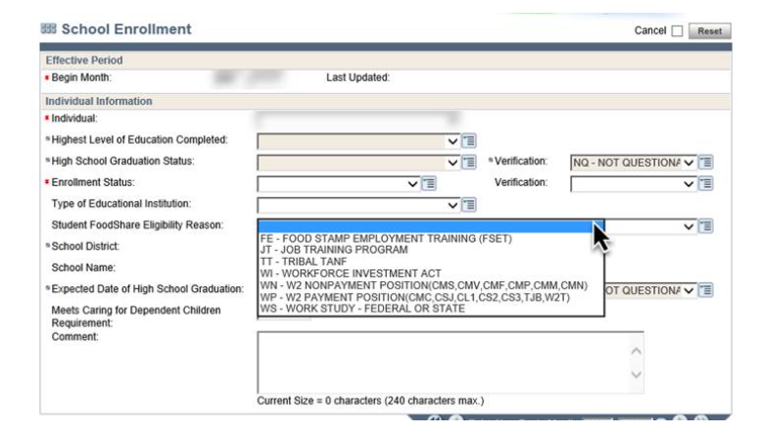
School Enrollment Page

Slide 17
Questions?

