Slide 1
Safe at Home
January 25, 2024

Slide 2
Safe at Home Introduction
Safe at Home is a statewide address confidentiality program administered by the Department of Justice
The intent of Safe at Home is for those who fear for their safety to be able to maintain a private, confidential home, work, or school address and gain some peace of mind
Participants use and receive mail at an assigned address in lieu of their actual address. Safe at Home then forwards their mail to their actual address
Safe at Home provides a legal substitute address for people who fear for their physical safety

Slide 3
Verifying Safe at Home Participation
Safe at Home provides participants with an authorization card. A copy of this card should be scanned into ECF
In order to communicate with Safe at Home on the applicant's behalf, the applicant will need to sign in writing onto the release of information Form F-02340. When using Form F-02340:
The name and direct contact email and/or phone number of the assigned case worker must be noted on the form.
Fax the form to Safe at Home 608.261.8660 or email safeathome@doj.wi.us.
The completed release of information form F-02340 will then need to be scanned into the ECF

Slide 5
Agency Responsibility
Each county appoints one person, with a supervisor as a backup, to process all confidential Safe at Home cases in their agency
When working with the Safe at Home participant population, participant safety and confidentiality are critical. The goal of this program is to keep victims safe and prevent their abusers from finding them
State law prohibits the use or sharing of the participant’s home, work, or school address.
Do not divulge information about the member or family members for any purpose not connected with the direct administration of the benefit programs.
Penalties for unauthorized release of an applicant or member’s information may include a fine of $25 to $500 or imprisonment of 10 days to more than one year or both

Slide 6
Application Process
The worker that receives the call on the consortium call center should process the application completely.
Explain to the applicant that a Personal Identifier will be established for security purposes. This identifier will be asked for when information is being provided or updated for their case. The Personal Identifier will be the #S### found on the authorization card. No clues shall be given to the caller to indicate what or where to find the Personal Identifier. If the application is received via ACCESS or mail, contact the participant to establish the Personal Identifier
Note: Safe at Home employees are exempt from having to provide the Personal Identifier.

Slide 7
Application Process
List the Safe at Home address as the Household Address.
The County of Residence field should be updated and communicated to the applicant as follows:
If applicant provided a County of Residence: Update to reflect their actual county of residence
If applicant did not provide a County Residence: Leave as 13-Dane County which is the county of the Safe at Home address.
County Agency contact information for the provided County of Residence, or Dane County if a County of Residence is not provided by the applicant should be provided to the applicant.
Transfer the case to the County/Agency in which the case will be held. The Transfer Coordinator will assign the case to the designated Safe at Home worker.
Email the supervisor of the Safe at Home worker in the County/Agency in which the case will be held to make the case confidential

Slide 8
Application Process
If the applicant wants access to an HMO through BadgerCare Plus or a Medicaid program of assistance that is only available outside of Dane County, they need to provide their actual county/tribe of residence
In the Household Address section, do the following:
Enter the applicant’s chosen County of Residence
Enter the agency address of the county the member has chosen.
Enter “Safe at Home” in the Additional Address Info field.
In the Mailing Address section, select the "Household has an alternate mailing address" checkbox.
Enter the Safe at Home assigned address as it appears on the member’s Authorization Card into the mailing address, enter the applicant's Safe at Home identification number (#S###) in the Apt field and use the Safe at Home ZIP (53707-7188)
CWW provides a suggested Post Office address and indicates the SAH identification number in the Apt field is invalid. Select Override Post Office Suggested Address - Keep address listed in 'Original Address' section to save the address.
To be used as "Address Verification" (only one of the following forms of verification is needed):
Safe at Home Authorization card
Email confirmation from the Safe at Home program (OW - Other Acceptable Written)
Verbal confirmation from the Safe at Home program (CC - Collateral Contact Oral)
If the member wants to end their HMO enrollment or switch to an HMO that is available in Dane County, change the County of Residence to 13-Dane in the “Household Address” section

Slide 9
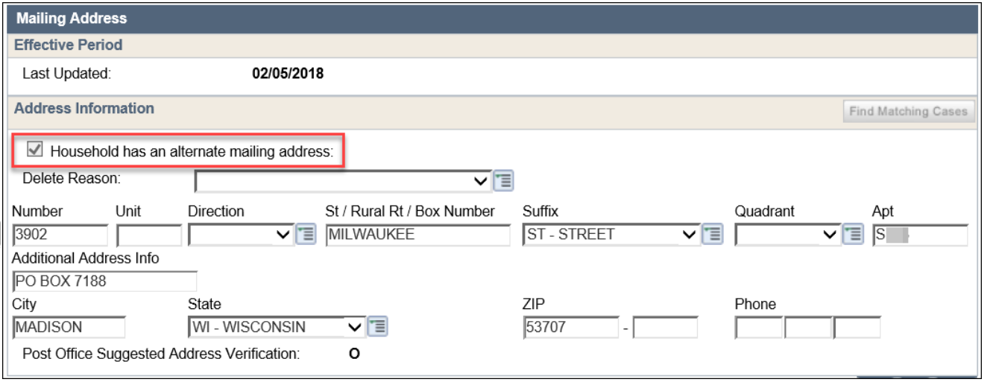

Slide 10
Application Process
Mail will take longer to get to Safe at Home participants due to the mail-forwarding system that is in place. Take the following actions when requesting verifications from a Safe at Home participant:
Tell the member their case will be made confidential
Explain that they will have limited viewing in ACCESS
Paperless correspondence is not an option for confidential cases
When verification of information is needed, attempt to contact the member directly to notify him or her of the needed information and due dates
Automatically extend the due date by 10 days to ensure the member has enough time to receive the Verification Request Letter
Document in the case comments that the verification due date was extended by 10 days due to mail delivery delays
Advise participants that verification with their actual addresses should be redacted prior to submission.

Slide 11
Application Process
Case Comments should be entered and flagged as important
Include the following details in the comment at application, SMRF and Renewal
Applicant or member is in Safe at Home
How participation was verified (i.e. participation card, Safe at Home contact)
No additional verification of the members actual household address or residency is needed (unless the member or Safe at Home reports the member is no longer participating in the program, then regular verification rules will apply)
The CWW Household address which would include the county agency address (if different than the Safe at Home information). The Mailing Address if applicable is the applicant's Safe at Home mailing address

Slide 12
Ongoing Eligibility
At Renewal, contact Safe at Home to verify that the member is still a participant in Safe at Home. Safe at Home can be contacted by emailing safeathome@doj.state.wi.us or calling 608.266.6613
If a change of address is reported on the SMRF, verify if the member is still a participant in Safe at Home
If the member is no longer in Safe at Home, they must submit residency and address verification according to program rules

Slide 13
Child Support Good Cause
Good cause should automatically be given to the Safe at Home participant. If the participant wants to work with Child Support, they should inform the Child Support Agency of their safety issues and their interest in receiving Child Support services

Slide 14
Work Requirements
Safe at Home participants are granted an exemption from the work registration requirement and the ABAWD work requirements for being physically and mentally unable to work due to security concerns

Slide 15
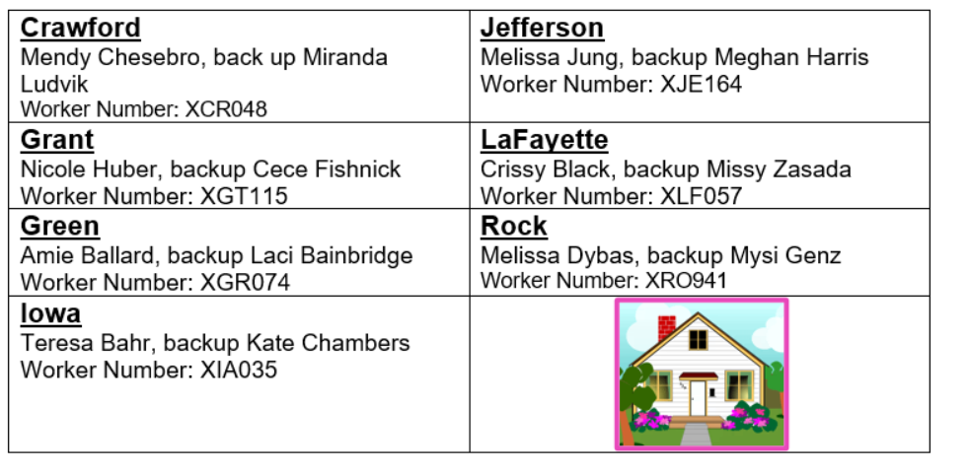
Southern Consortium County Contacts

Slide 16
References
Safe at Home is governed by Wis. Stat. § 165.68
Operations Memo 18-J8
CWW Process Help chapter 77
https://www.doj.state.wi.us/ocvs/safe-home

