Slide 1
Priority Service and Expedited Issuance
January 11, 2021

Slide 2
Overview
Priority Services and Expedited Issuance
Verification Requirements
Interviews
Scenarios
FoodShare Contact Attempts Page
Priority Service Determination Page
Auto Update and Manual Updating the Priority Service Determination Page
Resources

Slide 3
Priority Services & Expedited Issuance?
Priority Service screens all applications for potential eligibility for expedited issuance and faster service from the agency.
Expedited issuance benefits must be issued by the seventh day after the application is filed.
A person or food unit may be eligible for priority services and expedited issuance if:
Their total monthly gross income and available assets are less than the monthly allowable Standard Utility Allowance and monthly shelter expenses; or
Their gross monthly income is less than $150 and they have $100 or less in available liquid assets; or
Their food unit includes a migrant seasonal farm worker, who is also defined as “destitute” by meeting all three of the following criteria:
Assets are $100 or less, and
The only income received by the food unit prior to the application filing date was from a terminated source, and
The food unit does not expect to receive more than $25 from a new source within 10 calendar days from the date of application

Slide 4
Verification Requirements
A food unit eligible for expedited benefit issuance is only required to provide verification of identity of the primary person (applicant) before the expedited benefits can be issued.
The worker should attempt to verify ID of the primary person through data exchange if ID verification has not yet been received.
Other required verification items must also be requested, but the worker should not delay the issuance of expedited benefits pending the receipt of the other requested verification.
There is no limit to the number of times a FoodShare assistance group can be certified under expedited procedures as long as the assistance group:
1. Submitted all the required verifications within the last 30 days application processing period following an expedited issuance, or
2. Was certified under normal processing standards since the last expedited certification.
If there is other outstanding verification, CWW will allow confirmation of the month/s of expedited issuance but will deny ongoing months with a failure code reason related to expedited verification requirements. After confirming the expedited issuance, the worker will need to run eligibility a second time to place the case in pending status and generate the verification checklist. The worker should also change the verification due date on the checklist to the 30th day of the application and suppress any incorrect notices.

Slide 5
Example
Garfield Cat applies for FoodShare on August 5th. He reports no income or assets and says he is responsible for a shelter expense of $50 in rent as well as a phone utility expense. He is determined Priority Service eligible. The worker completes the interview with Garfield on August 6th. Garfield reports no income in August but reports that he just started a job at Cat Shack and will receive his first paycheck in September. The only outstanding verification requirement is Garfield’s new employment. The worker confirms expedited benefits for August and then re-runs eligibility to pend ongoing benefits for verification of employment.

Slide 6
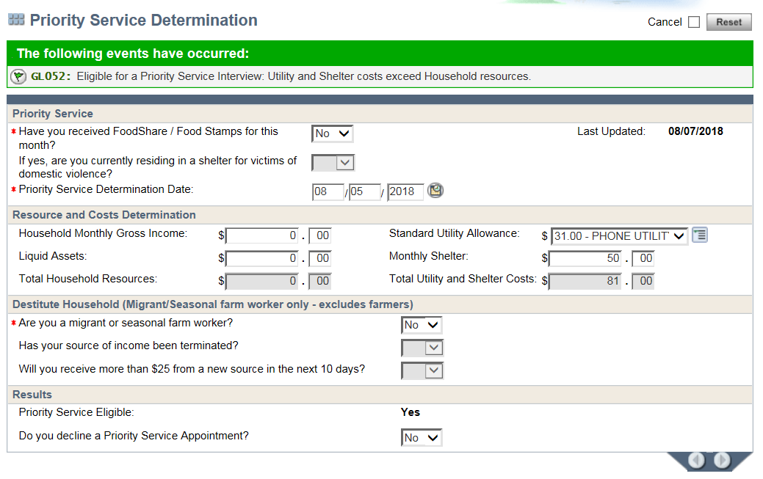
Update the Priority Service Determination Page based on answers provided by the customer. Enter the appropriate utility allowance that corresponds to what utilities the customer is responsible for paying. An informational banner will display indicating priority service eligibility.

Slide 7
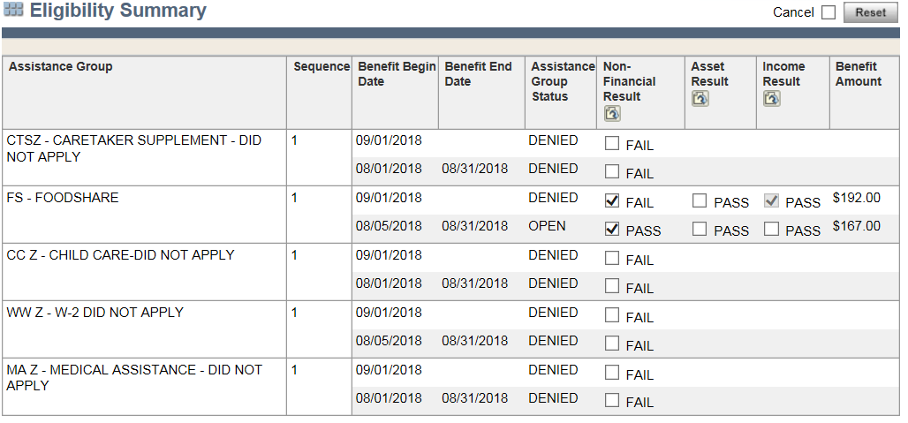
Since it is prior to Adverse Action, FoodShare are opening for August only.

Slide 8
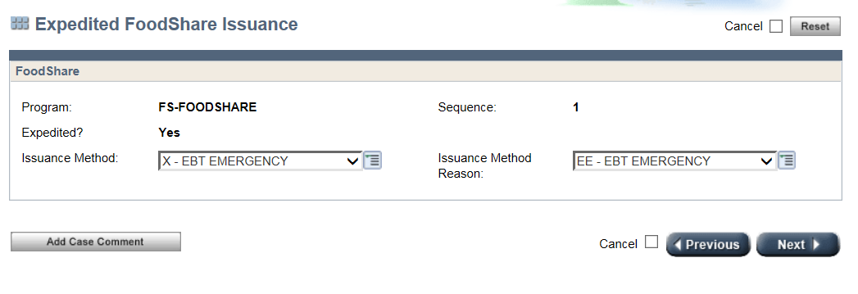
This indicates that expedited FoodShare are being issued to the customer.

Slide 9
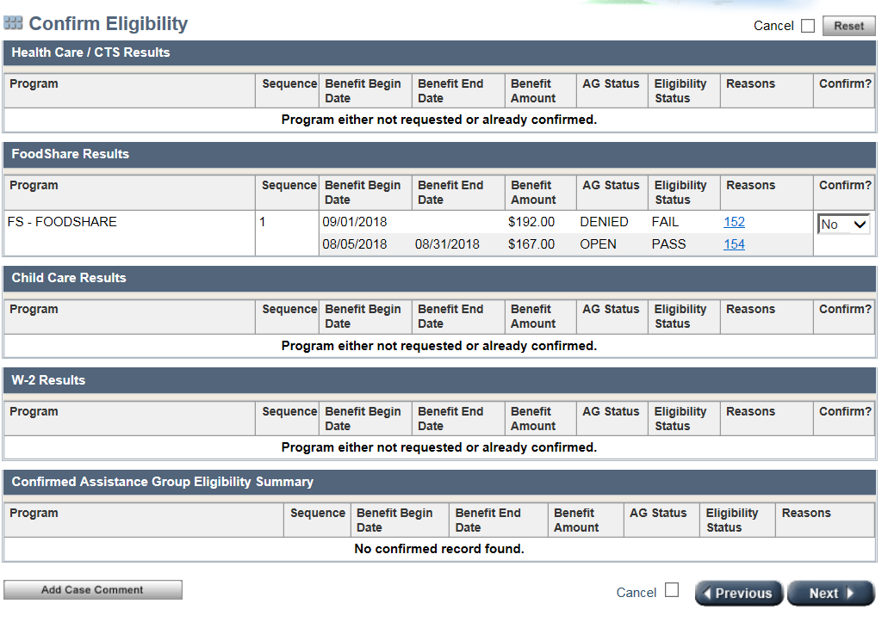
The worker confirms August benefits passed and ongoing months fail.

Slide 10
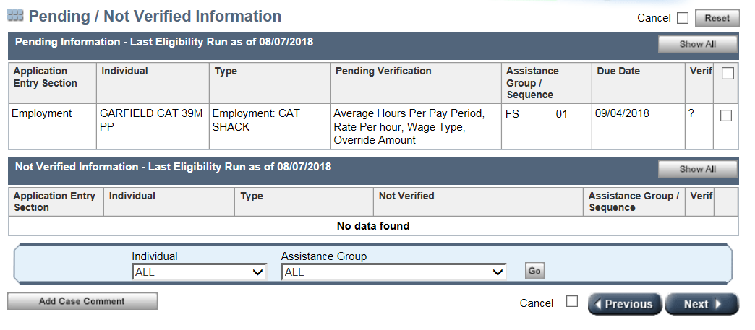
After confirming expedited benefits, the worker will need to re-run eligibility to pend ongoing benefits for any outstanding verification items.

Slide 11
Interviews
Workers must make at least two attempts to contact an applicant to complete the interview on the same business day the application is received or by the end of the next business day.
Workers must allow at least 15 minutes between the first and second attempt to contact the applicant/member.
When contact is made by phone, the worker should make every effort to complete the interview with the applicant. If the interview cannot be completed that day, the worker must schedule an interview appointment within the seven-day time frame.
For scheduled appointments, the worker must make two attempts to contact the applicant at the time of the scheduled interview. If that attempt is unsuccessful, the worker should make a second attempt 15 minutes after the first call. The worker should document the contacts made on the FoodShare Contact Attempts panel. The workers should then run the case through the driver flow and pend FS for interview, which will generate the appropriate notices to the customer.
If you receive a call on SCC from a customer requesting to complete an interview, the interview should be completed during that phone call. The customer should not be told they will receive a call back from the county worker who made the original attempts.

Slide 12
Interviews and the FS Contact Attempts Page
Every time the worker tries to reach the household for an interview, the details of the contact attempt must be recorded using the FS Contact Attempts panel, which is available on the Interview Details, RFA Comments, and Case Comments pages. This panel is used to track processing timeliness.
Comments entered on the FS Contact Attempts panel do not transfer into the main case comments section of CWW. Because they do not transfer over, it is important to get in the habit of reviewing comments in the FS Contact Attempts panel as well as the main case comment section of CWW.
Reminder: Postponing the Interview is no longer allowed as of 5/31/2020.

Slide 14
Priority Service Determination Page
The information entered on the CWW Priority Service Determination page is used to determine if the applicant is eligible for priority services.
This page must be completed each time a new application is submitted for FoodShare.
Customers may be eligible for priority service after a break in service and the Priority Service Determination page will not display within the review driver flow unless the FS Program Request Page indicator has been changed from a N to a Y. The worker must navigate to the Priority Service Determination Page and determine eligibility when the page does not display in the driver flow.
It is very important that this page be completed using the best information available.
When a customer applies through ACCESS and does not enter a value in response to a question that relates to getting faster service for FoodShare, the page will show a blank field. A zero will only appear if the applicant manually enters a zero. When a worker is processing the ACCESS application, the reported values should not be changed.
If a worker does not enter a value into a field within the Resource and Costs section of the Priority Service Determination page in CWW, the page will show a blank field. A zero will only appear if the worker manually enters a zero.

Slide 15
Case Scenarios
Scenario #1
Incorrect Action:
Sue applies for FS through SCC and is determined priority service eligible. The worker conducts the interview and pends the case for verification of identity of Sue (the primary person). Expedited FS is not issued because the case is pending for the primary person’s ID verification. Sue calls in to SCC and the agent finds that ID verification was available in ECF from a previous case.
Correct Action:
Sue applies for FS through SCC and is determined priority service eligible. The worker conducts the interview and searches ECF using Sue’s SSN and pin# and is able to verify the identity of the primary person because Sue had previously had an open case. The worker is able to issue expedited FS to Sue.
Note: workers should also search other data exchanges for ID verification.

Slide 16
Automatic Update of Priority Service to Non-Priority Service
On the seventh day after the application filing date, the FoodShare Priority Service application will be updated automatically to a regular FoodShare application through a nightly batch process if:
The interview is marked as pending on the Interview Details page, and
Two contact attempts have been recorded using the FS Contact Attempts panel.
This automatic update will also occur if the interview is scheduled for a future date that falls outside the seven-day processing time frame.
When a Priority Service application is updated automatically to a regular FoodShare application, the work item type and due date will be updated accordingly. For updated applications, the Priority Service Determination page will updated to display “Yes - SYSTEM” for the question “Do you decline a Priority Service Appointment?”

Slide 17
“Yes-System” displays after an automatic update of the page.

Slide 18
Updating the Priority Service Determination Page
There may be times when the worker will need to update the Priority Service Determination page so that the FoodShare Priority Service application shows as being processed “timely.”
Workers must check the work item to see if it is updating correctly and if it is not, will need to update the Priority Service Determination page accordingly.
The work item will show that a FoodShare Priority Service application is due 7 days after the date of receipt (filing date).
If a PS FS application changes to non-PS, or for some reason expedited benefits are not able to be issued (no ID verification, etc.), the worker should check the work item to make sure that the due date has changed to 30 days from the date of receipt (filing date). If it is has not, the worker should update the Priority Service Determination page to fail PS eligibility by entering assets of $1000. The worker must also update the Priority Service Determination Date to that day’s date.
If a non PS FS application changes to PS and the worker sees that FS are issuing expedited, before issuing and confirming the benefits, the worker should go back to the PS Determination Page and update the Priority Service Determination Date to that day’s date.
After expedited FS benefits have been issued and the case was pending for verification items, best practice is that the worker should update the PS Determination Page with the current date and assets of $1000 after the receipt of verification items and prior to confirming ongoing FS benefits.

Slide 19
Updating PS Determination Page Case Scenario
Scenario #1
Beverly applied on ACCESS for FS only and was determined priority service eligible. The worker calls Beverly to complete the interview and is able to reach her by phone. During the interview, Beverly reports income that was not listed on her ACCESS application. The income she reported makes her no longer priority service eligible. The case is pending for verification of Beverly’s wages so benefits will not be confirmed that same day. The worker checks the work item and the due date still shows 7 days from the filing date. The worker manually updates the Priority Service Determination page with the current day’s date and the income amount reported during application to fail priority service eligibility. The worker then checks the work item again and the correct due date of 30 days from the filing date is showing.

Slide 20
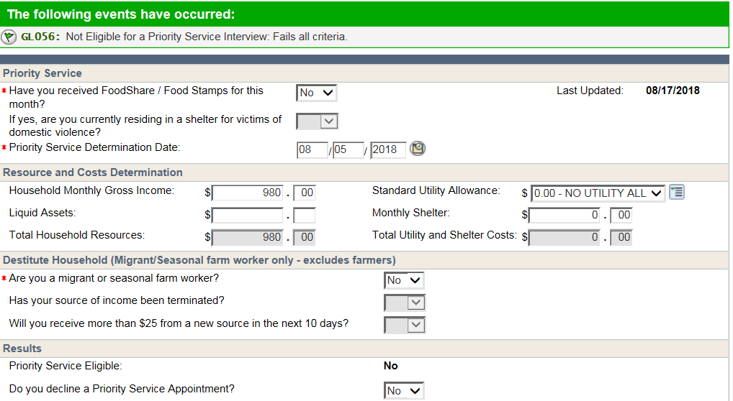
Updating PS Determination Page to fail PS Eligibility
Update with the income reported during the application to fail PS eligibility
Update this field with the current day’s date
Make sure this changes to “no”

Slide 21
Updating PS Determination Page Case Scenario
Scenario #2
Barbie applied on ACCESS for FS only and was determined not priority service eligible. The worker calls Barbie to complete the interview and is able to reach her by phone. During the interview, Barbie becomes eligible for priority service and the expedited benefit issuance screen comes up. The worker is able to verify Barbie’s ID. Prior to confirming the expedited benefits, the worker manually updates the Priority Service Determination Page with the current day’s date. The worker then confirms the expedited issuance.

Slide 22
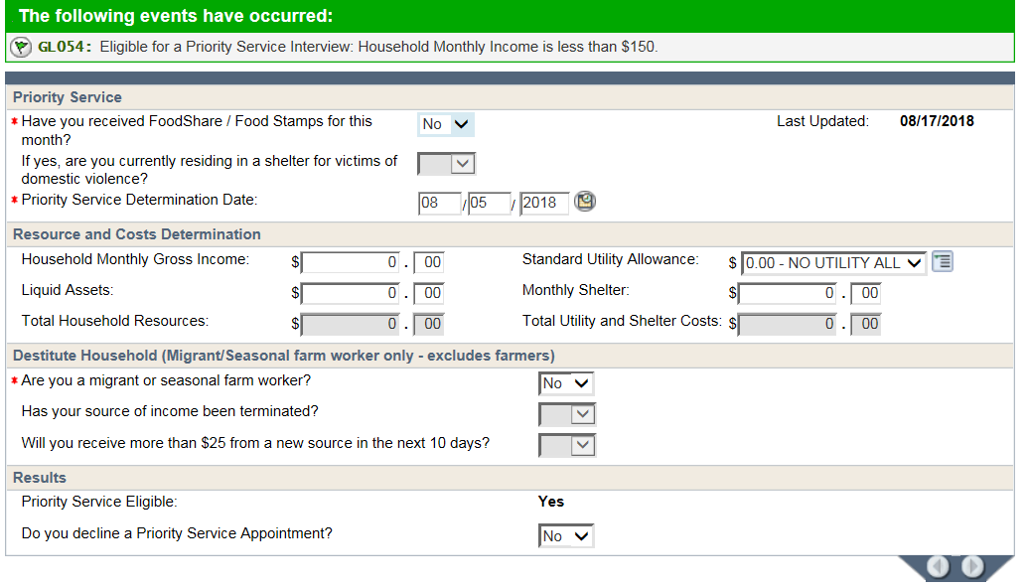
Updating PS Determination Page When Issuing Expedited FS
Update this field with the current day’s date

Slide 23
Updating PS Determination Page Case Scenario
Scenario #3
Hugh applied on ACCESS for FS only and was determined priority service eligible. The worker calls Hugh to complete the interview and is able to reach him by phone. During the interview, the worker is able to verify Hugh’s ID. Hugh continues to remain eligible for priority service and the expedited benefit issuance screen comes up. The worker then confirms the expedited issuance. Ongoing benefits are pending for WI residency. The worker re-runs the case to pend ongoing benefits.
10 days later, Hugh submits verification of WI residency. The worker processes the verification and prior to confirmation, manually updates the Priority Service Determination Page with the current day’s date and assets of $1000.

Slide 24
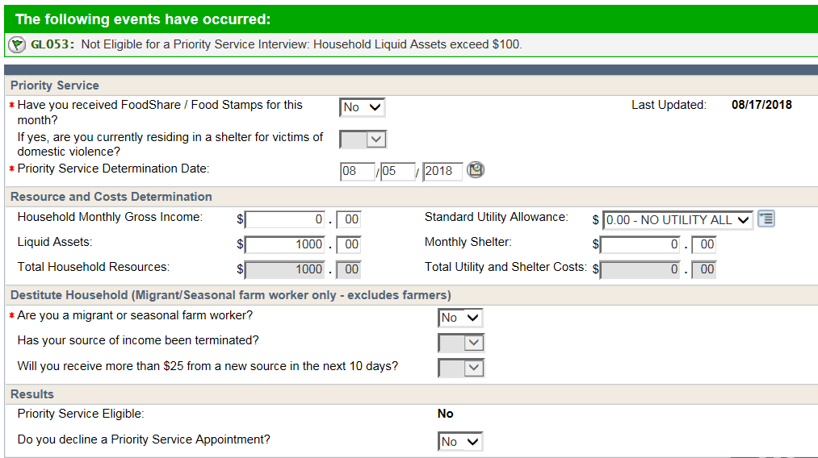
Updating PS Determination Page Expedited FS Have Been Issued and Case was Pending and Verifications are Received
Update with liquid asset amount of $1000 to fail PS eligibility
Update this field with the current day’s date
Make sure this changes to “no”

Slide 25
Resources
FSHB 2.1.3.1
FSHB 2.1.4
PH 1.4.2.1
PH 1.4.2.1.1
PH 1.4.2.1.2
PH 1.4.2.1.3
Ops Memo 17-18
Ops Memo 20-08

