Slide 1
Gap Filling
03/09/23

Slide 2
Overview
Gap Determination
EAI Page Creation and Scheduling
EAI Page
Worker Process for Validating Income
Eligibility Determined for Multiple Years
Other Important Information

Slide 3
Gap Determination
Applicants and members who are applying for or receiving MAGS, MAGA or MAGN, and fail only for exceeding the monthly income limit, are automatically tested using the annual income limits. This is Gap Determination
The first financial test is always monthly
CWW is programmed to schedule pages when necessary for the annual income determination. One of these pages is the Expected Annual Income (EAI) page
The following are the order of eligibility rules for the EAI page scheduling and gap determination requirements :
Is MAGS, MAGA or MAGN failing only for being over the monthly income test (self-attested or verified)? If yes, then;
Is the individual’s self-attested income on the Individual Reported Annual Income page over the annual income limit?
If yes, BC+ fails, no EAI page is scheduled, and no gap determination is required
If no, BC+ pends, the EAI page is scheduled, and the worker validates the annual income

Slide 4
EAI Page Creation and Scheduling
When a case meets the criteria for an annual income gap determination:
The EAI page is scheduled
Alert 604 “Potentially Eligible for Gap. Complete Expected Annual Income page” is created. Workers must delete this alert
BC+ pends for income (worker) validation
Best practice is to complete the EAI page (when it’s scheduled) when running eligibility and before confirmation. CWW will allow the page to be bypassed to finish the processing of other items (ex. FS interview). BC+ will pend until the EAI is updated
If the EAI page is not updated by the end of the day, an FYI VCL is sent. The VCL language is generic. This is because until the worker validates the page (or requests information) a gap determination cannot be completed

Slide 5
EAI Page Creation and Scheduling (cont.)
The EAI page is scheduled to pend for worker validation for individuals potentially eligible for and/or counted in the AG determination when MAGS, MAGA or MAGN fail for only the monthly income test, and any of the following conditions exist:
There is no EAI page for one of the required individuals for the year that eligibility is determined. EAI pages are only created for individuals who are potentially eligible and/or counted in the AG Determination (including children with monthly income budgeted) even if that individual has no income (for example, a spouse with no income).
An EAI page is in “W-Waiting Worker Validation” status.
The gap AG’s previous budgeted monthly income is different than the current budgeted monthly amount. This includes increases and decreases.
A health care application is processed

Slide 6
EAI Page
The page has five sections:
Annual Income Details
Earned Income
Self-Employment Income
Unearned Income
Deduction
Review each section and enter (validated) income amounts that should be counted for the annual income limit eligibility determination
If there is no income, workers can enter $0 or leave the field blank (CWW assumes $0 when no income is entered)
Most income (that needs to be validated) is already calculated and displayed from other pages within the case. However, workers must total amounts within sections where there are multiple income types
Workers must also pay special attention to unearned income (see PH 14.1.4.4 UNEARNED INCOME):
Unemployment Income: Workers must determine the amount of annual income expected to be received based on the individual’s UI records and add that amount to any other income listed in the Unearned Income section
Workers must validate and total information within each section of the EAI page for that income or deduction to count in the eligibility determination

Slide 7
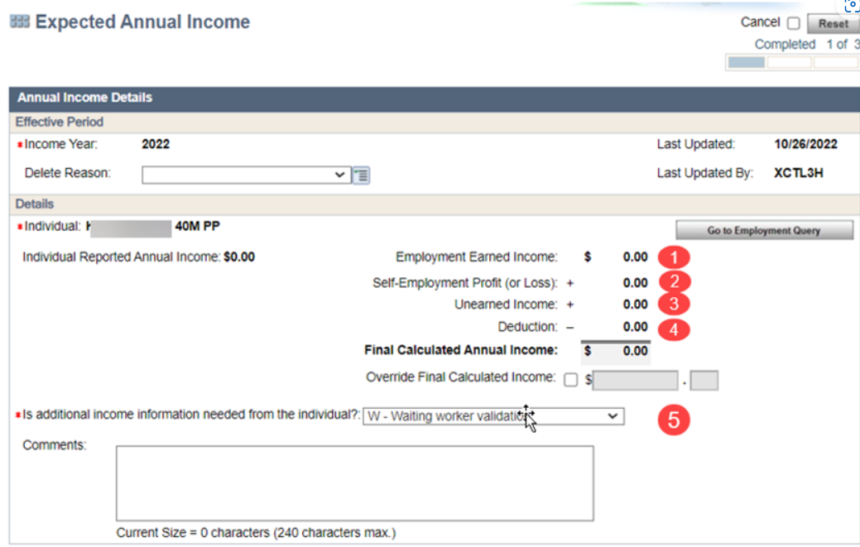
EAI Page (cont.)
1-The Earned Income section (PH 14.1.4.2)
2-The Self-Employment section (PH 14.1.4.3)
3- Unearned Income section (PH 14.1.4.4)
4-Deduction Section (PH 14.1.4.5)
5-Validating Income Section (PH 14.1.4.6)
*See PH for information on how to complete each section

Slide 8
Worker Process for Validating Income
Validating income, requesting additional information, or failing a BC+ gap determination is the last step in processing the EAI page. Such actions are taken only after all sections of the Expected Annual Income page have been reviewed, and income and deductions have been entered or updated
The “Is additional income information needed from the individual?” field is used to pend BC+ for worker validation, pend for more information from the applicant or member and used to fail BC+ for not providing verification
Valid responses are:
W-Waiting for worker validation: Requires workers to review, evaluate, and update the EAI page. Alert 604 is created. BadgerCare Plus pends until the status is updated to either V, P or F. After updating the status, workers must delete the alert.
Exception: If a worker must revisit the EAI page, but the status is P-Pending member information, the status does not change to W.
V-Worker validated: Requires workers to initiate eligibility, review determination results, and confirm the case now that annual income and deduction amounts have been reviewed.
P-Pending member information: Used when the worker cannot validate expected annual income and needs more information from the applicant or member. The worker must also add comments and specific details to the verification checklist to clarify requested information, as the language on the verification checklist is not specific.
F-Failed to provide information: Used when requested information is not provided by the applicant or member. Additionally, reason code 808 is generated on the notice (someone in the household did not provide annual income information to the agency)

Slide 9
Eligibility Determined for Multiple Years
CWW creates EAI pages for all years for which a request is running eligibility. Example 3: In February 2023, an application is received with a three month backdate request. EAI pages for 2022 and 2023 are created
Examples:

Slide 10
Other Important Information
If more information is needed from the applicant or member regarding expected annual income, the worker can send a VCL. Because this is an action needed request, the worker must add worker notes clearly detailing what is still needed. If nothing is added, a general VCL is sent asking the member to contact the agency right away
Some cases will take some critical thinking to determine which income to use depending on what you are doing. For example, an EAI page may have different income or SWICA information later in the year than earlier in the year. If the EAI page is scheduling it’s because a change has occurred that may impact the eligibility determination.
Is BC+ passing the monthly income test after the EAI page has been updated? Check to make sure all countable income is entered in each section’s “annual amount” field
Is income missing from the EAI page? Make sure the missing income is for the tax year displaying. For example, if the worker is running the case in January 2023, only income budgeted for January 2023 and forward is displayed. Workers can navigate to the previous tax year to see other EAI determinations
If a case is failing the monthly income test and the EAI page isn’t scheduled, check the Individual Expected Income Page. If the self-reported amount is over the annual 100% FPL the worker does not need to update the EAI page

Slide 11
Questions?

