Slide 1
Overpayments
Presented by Mary Donahue, Laura Middleton and Adam Voss
01/13/22

Slide 2
Table of Contents
Definition and Types of Overpayments 3
Pandemic Processes 6
Finding Existing Overpayments in Mainframe 7
Notices 10
Returned Mail 17
General Overpayment Reminders 18
Date of Discovery 19
Lookback Period 20
Minimum Threshold 22
Creating a referral in BRITS 24
Liable Individuals 29
Overpayment Processing—Mainframe and BRITS 31
MA Overpayments and IPV 47
How to Enter a FS IPV 52
PACU 16
Duplicate Benefits 23
Case Comments 46
Extensions to Existing Overpayment Referrals in BRITS 54

Slide 3
Definition of an overpayment
An overpayment of benefits occurs if a member receives benefits they were not entitled to or more benefits than they were entitled to.
FoodShare and health care programs have very specific nonfinancial and financial eligibility criteria. An assistance group is either eligible or not eligible.
If an individual received benefits but it is later discovered that s/he did not meet the eligibility criteria, an overpayment may exist.
Workers must review cases thoroughly to determine if an overpayment has occurred.
For healthcare, the worker is required to determine if the person could have been eligible in any other category of Medicaid before requesting an overpayment. For example: the worker should assess if a customer would have been eligible under GAP filling.
There are instances when there may be an overpayment for the past but the individual or assistance group remains eligible for ongoing benefits such as when:
An error was made in determining the amount of benefits to be received (received more FoodShare than s/he should have).
The premium, co-pay or cost share calculation was incorrect.
A deductible amount was incorrect

Slide 4
Types of Overpayments
There are three types of overpayments: Non-client error, Client error and Intentional Program Violation (IPV).
Non-Client error occurs when a worker keys the wrong information, fails to act on available information, misapplies policy or the system gave the customer more benefits than s/he was entitled to receive.
Client error occurs when a customer unintentionally omitted or provided erroneous facts and received more benefits than s/he was entitled to receive.
Intentional Program Violation (IPV) occurs when a customer intentionally omitted or provided erroneous facts to receive more benefits than s/he was entitled to, and the individual was found guilty of the IPV by a court or an administrative disqualification hearing OR by signing a Waiver of Administrative Disqualification Hearing form (F-16039) for Food Share or an Intentional Health Care Program Violation Acknowledgement form (F-02913) for Health Care.

Slide 5
Overpayments cont’d
Child Care overpayments are required to be recovered—even if they are due to agency error.
We cannot recover agency error overpayments for Medical cases.
Food Share errors are required to be recovered for agency and client error.
If the overpayment was based on the average quarterly SWICA wages, the client should be encouraged to send in their pay stubs or payroll printout for recalculation using actual income….this could reduce or eliminate the overpayment amount. If you are working on documents and come across these, please email the overpayment worker in the county of residence.

Slide 6
Pandemic Processes
No Health Care overpayments are being processed for errors during the Public Health Emergency timeframe, 03/2020--current. ***CTS does not fall under MA overpayment rules so, we can process CTS overpayments during the PHE.
No Child Care overpayments are being processed for the periods 03/2020--06/2020 and 03/2021--06/2021 unless they are due to IPV or zero-attendance hours in that month.
If a client would have been eligible for at least $1.00 in FoodShare, no overpayment is created during the Public Health Emergency timeframe, 03/20—current.
No recovery is allowed of the additional 15% FoodShare issued 01/21—09/21 or the additional $95 emergency supplement issued 04/21—current.
If more people were included in the household than should have been, then you can collect the difference between the FS maximum allotment amounts. Example: FS issued for group of 3 but should have been group of 2.
You may need to manipulate BVBD using PF24 or use the Overpayment Calculator Tool to adjust the claims as the system does not recognize that these amounts are not recoverable.

Slide 7
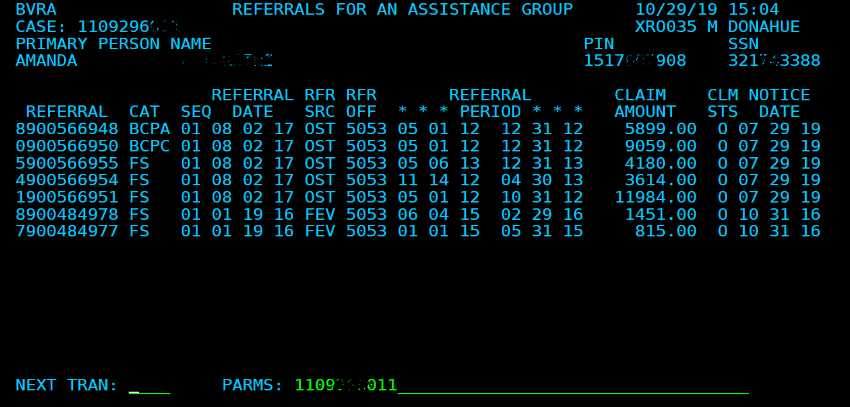
Finding Existing Overpayments on a CASE
To find a list of overpayments for a case, you can look it up in mainframe on TRAN: BVRA with PARMS: Case Number.
This list will show you the claim referral number(s), program type, referral period, claim amount and notice date.
Copies of all paperwork/manual notices should be in ECF, coded OP, under the corresponding case number.

Slide 8
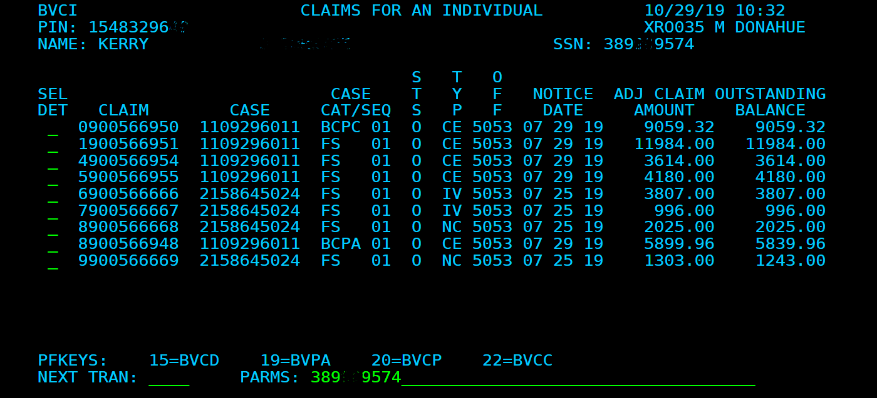
Finding EXISTING Overpayments for a PERSON
To find a list of overpayments by a person, you can look it up in mainframe on TRAN: BVCI with PARM: SSN or PIN.
This list will show you which case(s) the overpayments go with, the original overpayment amount, and the current balance owed.
Copies of all paperwork/manual notices should be in ECF, coded OP, under the corresponding case number.

Slide 9
To see overpayment information in BRITS
To see overpayment information in BRITS, click the button circled in the screenshot below.
It will open this box, shown below, at the bottom of the screen. It shows the initial amount of the overpayment and the current balance owed.

Slide 10
Overpayment notices Overpayment Notices are mailed out the next business day after the overpayment is entered. The arrow indicates where the OP timeframe and amount are listed.

Slide 11
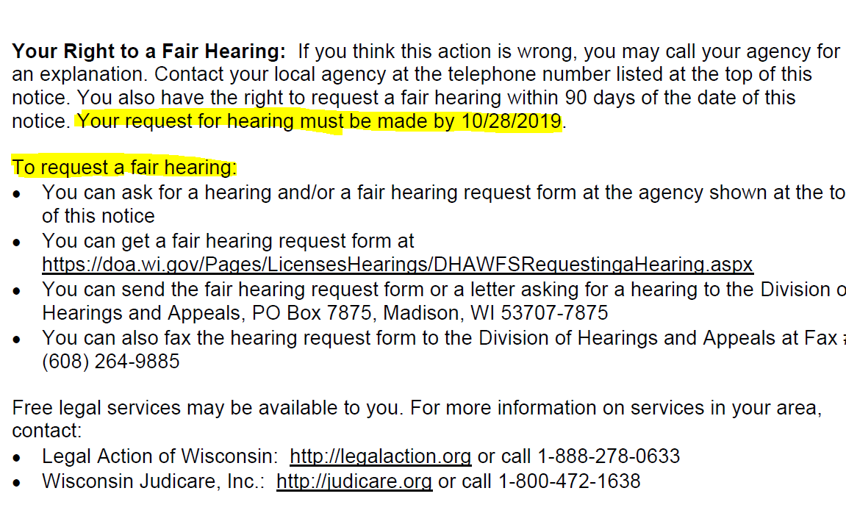
Overpayment notices cont’d
Overpayment notices include the deadline to file an appeal and the ways to request a fair hearing.

Slide 12
Repayment Agreement (RPA)
The Repayment Agreements do not get mailed out until the first business day after the first of the following month (in case callers state they haven’t received this yet).
Example: If the overpayment is entered 10/3, the Overpayment notice will go out the next day 10/4. The Repayment Agreement will go out 11/4.
The RPA will not get mailed out at all if a Fair Hearing request is received prior to its mailing date. Once a fair hearing decision is made, the RPA will mail out if still needed.

Slide 13
Sample RPA

Slide 14
Sample RPA cont’d

Slide 15
Sample RPA cont’d

Slide 16
Public Assistance Collection Unit (PACU)
Payment related issues:
Refer the client to the Public Assistance Collection Unit (PACU) for all payment related issues such as payment arrangements, repayment agreement questions, late or missed payments.
The PACU phone number is 1-800-943-9499.

Slide 17
Returned Overpayment Documents
If the overpayment documents come back as returned mail with a forwarding address, re-mail the CWW-generated notices as well as the manual forms from ECF and document that you did so in case comments.
This information is important in the event the customer files for a Fair Hearing. If the remailed notices are not also returned, the customer will be assumed to have received them.

Slide 18
General Overpayment Reminders
When looking at notices to support an overpayment referral, be sure the notice reflects the correct program. A FoodShare notice immediately before the overpayment period does not also make that the Health Care reporting limit. The notice with the Health Care reporting requirements must also be found.
If the notice refers to both FS and Healthcare (a combined notice), the income reporting limit listed is most often the one for Healthcare (not FS).
The FS FPL for change reporting amount can be found on the Table of Income and Allotment Limits.
Be sure to check that the ongoing income is correct or add new employment, if found. Failure to do this results in an agency error and MA agency errors are not recoverable. FS and Child Care can recover agency errors.
Multiple claims may be created in BRITS for a case if the referral source is SWICA.
Review case for GAP eligibility.

Slide 19
Date of Discovery Effective 12/01/21 OPS Memo 21-25 *This information does not apply to Child Care overpayments.
FoodShare and health care programs will define the date of discovery as “the date the worker creates the overpayment claim in the system and triggers notice to the member.”
If the requested information needed to confirm the amount of an overpayment is not returned or is incomplete, the best available information may be used.
This includes SWICA wage queries or other data exchanges.
Per OPS Memo 21-25, this applies to both FoodShare and health care programs.

Slide 20
Lookback Period Effective 12/01/21 OPS Memo 21-25 *This information does not apply to Child Care overpayments.
The FoodShare look back period for client and non-client errors will be twelve months from the date of discovery.
The look back period will remain at six years preceding the date of discovery for duplicate benefits, FoodShare IPV, or trafficking claims.
Recoverable health care overpayments not based on fraud will have a look back period of twelve months from the date of discovery.
The lookback period for health care overpayments based on fraud convictions, a signed Intentional Health Care Program Violation Acknowledgement form, or a member receiving duplicate benefits is limited to six years preceding the date of discovery.

Slide 21
Lookback Period Examples
Example 1: Sue applies for FoodShare and BadgerCare Plus on November 6, 2021 and is found eligible for both programs. On January 20, 2022, the IM worker discovers the earned income was miscalculated on Sue’s case. The IM worker correctly calculates the earned income and Sue is found ineligible for both FoodShare and BadgerCare Plus. The overpayment claim is created on the same date the case was corrected. The look back period for FoodShare, based on the date of discovery, is November through February. There is no overpayment for BadgerCare Plus because it was an agency error and therefore a non-recoverable overpayment.
Example 2: Steve has been receiving FoodShare for the last 18 months. The IM Worker receives verification on November 5 that Steve falsified his information with the agency, and he has been a resident of Illinois the entire time. Steve is not receiving FoodShare in Illinois. The agency does not pursue an IPV. The worker enters the overpayment claim on November 6 and a notice is sent to the member. The overpayment is considered client error and the look back period is reduced to twelve months from the date of discovery, December through November.

Slide 22
Minimum Threshold Effective 12/01/21 OPS Memo 21-25 *This information does not apply to Child Care overpayments.
Beginning December 1, 2021, the minimum threshold for each claim is $500 for client and non-client error FoodShare overpayments for both participating and non-participating food units, and for recoverable health care overpayments.
For members with overpayments for both FoodShare and health care, the threshold policy may result in the agency creating a claim for one program and not the other.
If the overpaid amount is less than $500, no claim will be established unless it meets one of the following criteria:
• Health care overpayments based on fraud convictions or a signed Intentional Health Care Program Violation Acknowledgement form. F-02913
• FoodShare IPV claims
• FoodShare overpayments discovered through a State Quality Control (QC) review
• Overpayments related to a member receiving duplicate benefits.

Slide 23
Duplicate Benefits
FoodShare
Duplicate benefits are defined as receiving benefits for the same month in more than one state or more than one case (except for those residing in a shelter for battered persons).
Healthcare
Duplicate benefits are defined as situations in which a member moved out of state, enrolled in another state’s Medicaid program, and received services under Wisconsin Medicaid more than two months after the move occurred.
It will be very important to obtain verification from the state that issued the duplicate benefits, including the application date, benefit history for both programs, and the address on file if they are currently residing out of state.

Slide 24
Referring for Overpayment in BRITS
1) Log into BRITS. As of 12/13/21 you must use Chrome.
2) In the Create Referral section, enter the case# and then “tab”-- the primary person’s name, case office, county of residency and case worker will auto-populate.
3) Select the gatekeeper office for each program shown. This should be the client’s county of residence.

Slide 25
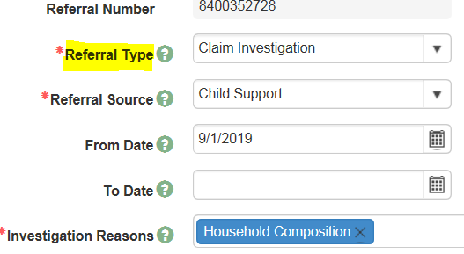
Referring for Overpayment in BRITS
4) Enter Claim Investigation as the Referral Type
5) Choose the Referral Source from the dropdown menu
NOTE: Multiple claims may be created for a case if the referral source is SWICA
6) Enter the From and To dates of the overpayment timeframe
7) Choose the investigation reasons from the dropdown menu

Slide 26
BRITS comments format
Enter all this information into the BRITS comment section when you refer a claim for overpayment. You do not need to follow this format for FEV/FRAUD referral. There are three examples below of information needed for an overpayment to be processed. In Rock, the Overpayment Specialists will send back BRITS overpayment referrals that do not contain all these comments:
Pursue as Fraud?
Programs involved:
OP Time Frame:
NOD Date and $ Limit:
Employer Name/EI Verif Requested?
COMMENTS:
Example 1
FRAUD? NO
PROGRAMS AFFECTED: FS
OP TIME FRAME: 01/21—11/21
NOD DATE AND $ LIMIT: 10/18/20 $1383.00
EI REQUESTED/RECEIVED: Received—Work Number QPS, EI Generac; Not received—Impact Confections
COMMENTS: Client failed to timely report new employment at QPS, Generac and Impact Confections.

Slide 27
BRITS Comments examples cont’d
Example 2
Pursue as Fraud? Yes
Programs involved: FS
OP Time Frame: 7/11/19-08/31/21
NOD Date and $ Limit n/a
Employer Name/EI Verif Requested? n/a
COMMENTS: Client applied for FS on 7/11/19 and stated she resided in WI and did not have an open case in any other state. Received Out of State usage report showing client has used all benefits in IL. Per IL DHS query, client also had open FS in IL when she applied in WI. Copy of IL benefit history in ECF.
*****If an IPV is done, you can recover the entire OP period. If you do not pursue an IPV, you can only recover benefits from the last 12 months.
Example 3
Pursue as Fraud? No
Programs involved: FS/MAGS
OP Time Frame: 5/21—8/31/21
NOD Date and $ Limit: 2/26/21 must report changes within 10 days
Employer Name/EI Verif Requested? n/a
COMMENTS: Customer failed to timely report incarceration. Incarcerated 4/2/21-9/6/21

Slide 28
BRITS cont’d
10) To finish the BRITS referral click Save (the floppy disk image below with the red dot)
11) Each county assigns referrals based on their internal process

Slide 29
Liable Individuals (Ref: FSH 7.3.1.2 Liability, BCPH 28.4.3 Determining Liable Individual)
For FS: All adult household members included in the group (or who should have been included) are liable for the repayment of overpaid FoodShare. This includes adult children aged 18 and over.
For healthcare: Unmarried co-parents are liable for their own portion of an overpayment as well as the amounts for any of their children. For a married couple, they are each liable for the total overpayment.
EXAMPLE: Barney and Betty have a 1-month overpayment. Barney’s Net Capitation was $440.08. Betty’s Net Capitation was $440.08. The overpayment total is $880.16. Since they are married, they are both liable for the full $880.16.
If they were not married, Barney would only be liable for his $440.08 and Betty would only be liable for her $440.08.
If there is also an overpayment for their son Bamm-Bamm they would share liability for it (regardless of marital status).

Slide 30
Liable Individuals—Cont’d (Ref FSH 7.3.1.2 Liability, BCPH 28.4.3 Determining Liable Individual)
If someone was included in the household, but should not have been included, they are not liable. An example may be a household reporting a change in household composition (someone moving out) and the agency failing to remove the individual. The overpayment still exists, but the person who should have been removed would not be liable.
Liable individuals on a claim can be seen on CARES screen:
TRAN: BVCL and PARMS: Claim Number.
Overpayments follow liable individuals when they move to other cases.
Example: Fred and Wilma have a FS overpayment of $300. They are both liable individuals on the claim. Fred moves out of Wilma’s home and into Barney and Betty’s home. Fred is added to Barney’s FS. Fred’s liability to the overpayment on his case with Wilma will cause a recoupment out of Barney’s FS case.
Each liable person will be mailed a copy of the Overpayment Notice and Repayment Agreement (RPA). All liable individuals need to sign the RPA and return it to PACU. If you manually add a person to the claim, the system will not issue an Overpayment Notice. Manually send them a Notice of Food Share Overissuance form, F-16028.
***See page 39 for adding or removing a liable individual.

Slide 31
Overpayment Processing—CWW
For FS, from the Case Summary Page, select the radial button for Initiate, Resume, or Terminate Simulation. MA overpayments must be calculated manually.
From the Simulation menu, select initiate simulation.

Slide 32
Overpayment Processing—CWw conT’D
Process for determining and calculating overpayment
For FS cases, use the actual income to determine if they exceeded the reporting requirements. Convert the income to determine any overpayment calculation. (FSH 7.3.2.1).
For BCP/MA claims, use the actual income that was reported or required to be reported in determining the overpayment (PH 31.3.4.2).
Exclude any income that was not reported and not required to be reported during this time period.
Run eligibility for the time period of the overpayment. Note the following:
Only 12 months at a time are allowed when running eligibility.
There may be more than one period based on length of overpayment and renewals on the case.
****If there is a renewal month that falls in the overpayment period and makes simulation fail months incorrectly, you should use the Food Share Wisconsin Overpayment Calculator tool found in
Forms—F-16030.

Slide 33
Overpayment Processing CWW cont’d
For FS, terminate simulation WITHOUT delete so the information is retained in CWW for the overpayment processing in CARES mainframe.

Slide 34
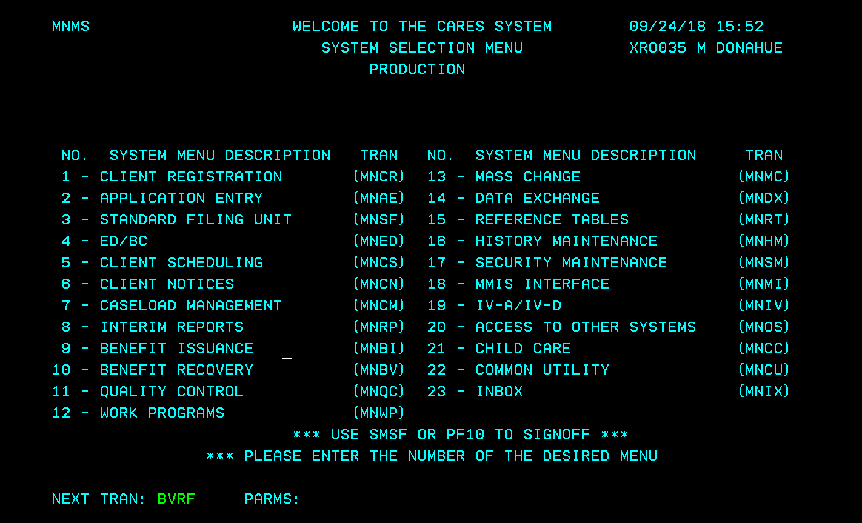
Overpayment Processing-Mainframe
1) Enter TRAN code BVRF with no PARMS and hit “Enter.”

Slide 35
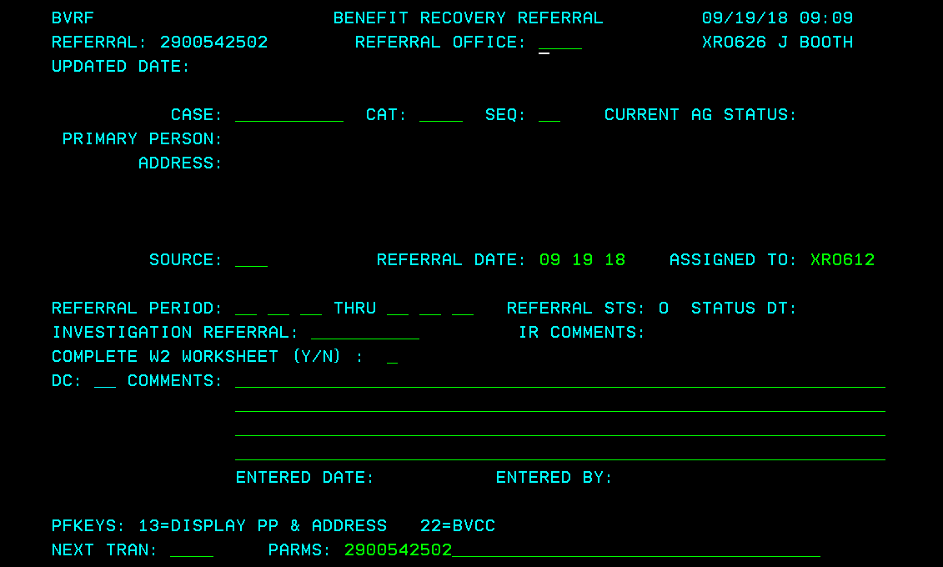
Overpayment Processing-Mainframe
2) This creates a new referral. The referral # displays at the top left corner of the page and in the PARMS. Write it down. If you forget to do this, you can find the claim number by going to TRAN code BVCI with the SSN or PIN.
X#####
2900xxxxxx

Slide 36
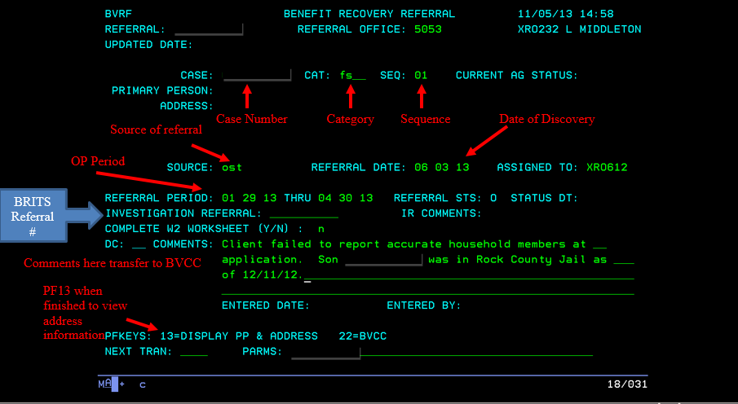
Overpayment Processing-Mainframe
3 )Enter the Referral Office, Case#, Category (CAT) and Sequence (SEQ)
4) Enter the source, assigned worker, referral date, referral period, and comments.
5) The investigation referral is the BRITS referral number. Note: The referral date is the date of discovery (the date the overpayment is entered into the benefit recovery system).
6) Press enter to create the referral. Comments from BVRF transfer to BVCC. TRAN to BVCC with the referral in PARMS to view or enter more comments.
7)Create separate claims for each sequence in the category (MAGA, MAGC, etc.).
X#####

Slide 37
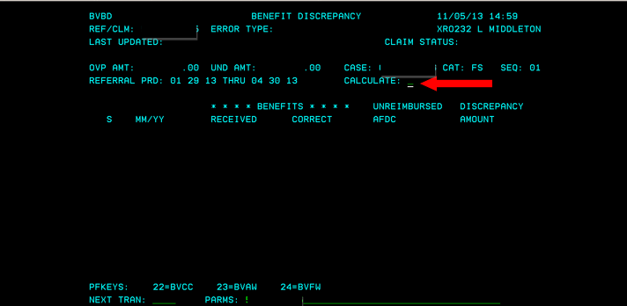
Calculating the Overpayment in Simulation
For FS only:
On the same day you run simulation, TRAN to BVBD, PARMS =Claim number
Enter “Y” in the “Calculate” field and press enter.

Slide 38
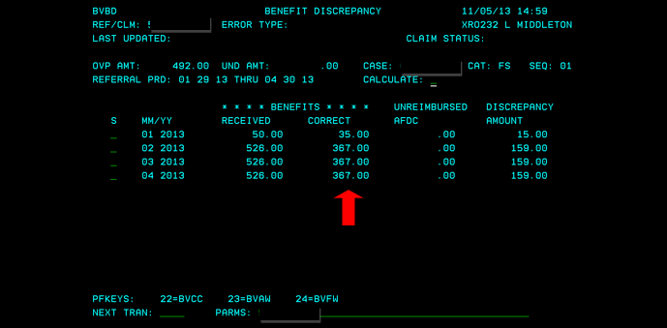
Overpayment Processing-Mainframe
CARES will pick up the correct benefits determined in simulation and compare them to the actual benefits issued. It then calculates and displays the total overpayment or underpayment amount. If the over/under payment amount does not seem correct, return to simulation and re-check your data. You may make changes in simulation, save them, and re-run the calculations in BVBD. If you want to see a budget, select the month and press PF24. You can make changes to any budget, if needed.

Slide 39
Overpayment Processing- Mainframe cont’d
Tran to BVCL (Benefit Recovery Claim), PARMS =claim number. The status is displayed. Enter the “Overpayment Reason” and “Error Type”. Codes can be found by entering “#” in the space.
Anyone over the age of 18 will be included as a liable individual on the claim.
BVCL will have the information regarding the overpayment period and original claim amount entered (FS only). If you used a manual FS worksheet, you need to enter the claim amount. You will need to fill in the claim amount for healthcare.
Use PF21 to insert a liable individual.
Remove anyone who should not be liable during the overpayment timeframe by putting a “D” in the DC field and enter a reason code. Place a # in the RSN field to display reasons.
If you manually add a person to the claim, the system will not issue an Overpayment Notice. Manually send them a Notice of Food Share Overissuance form, F-16028.
See screen shot on next page.

Slide 40
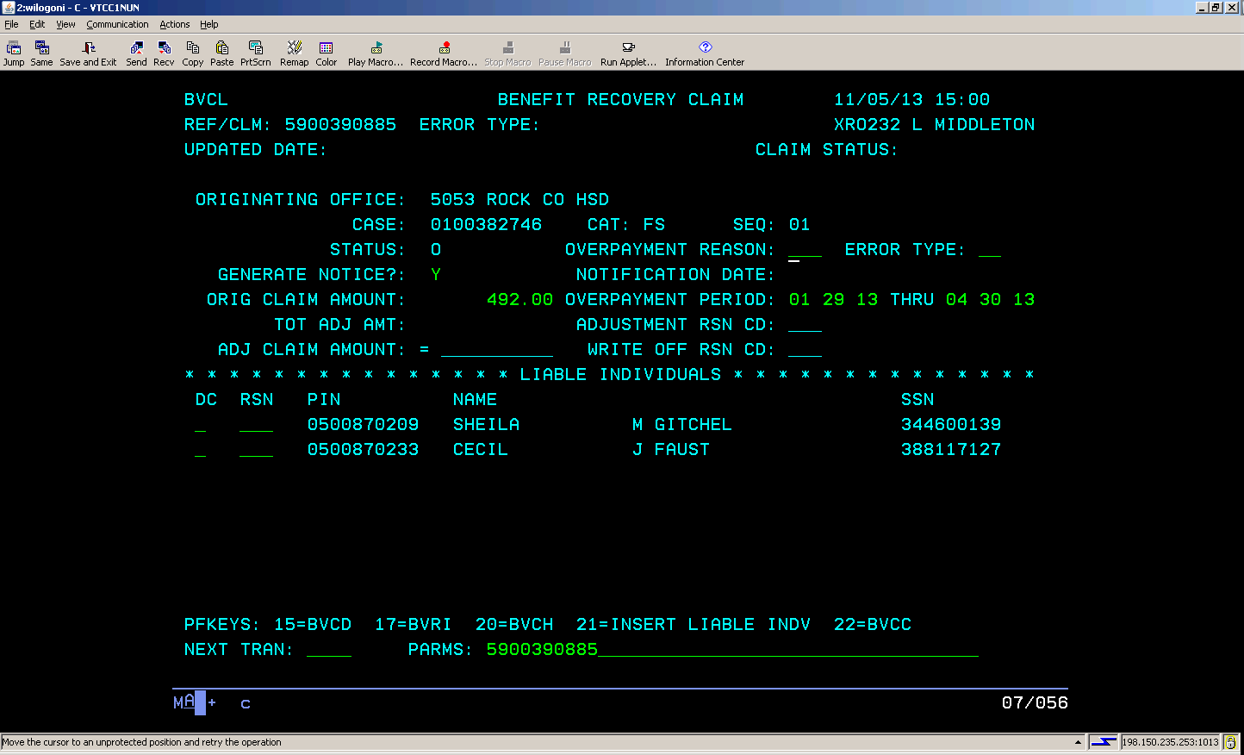
Overpayment Processing- Mainframe cont’d

Slide 41
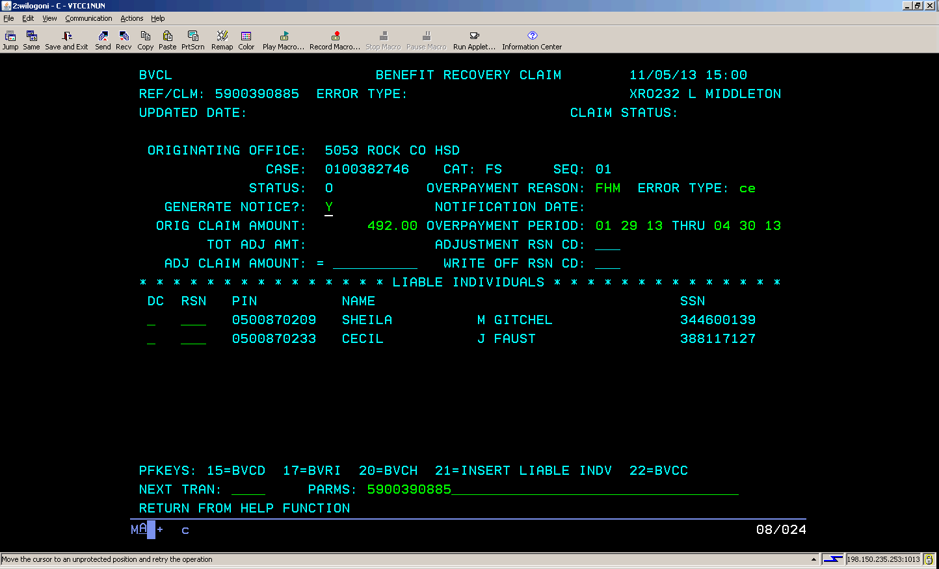
Overpayment Processing –Mainframe cont’d
Enter the Overpayment Reason and Error Type. Enter a # in the field to display options. Enter the claim amount for healthcare or FoodShare claims that did not use BVBD.

Slide 42
Overpayment Processing--BRITS
***Reminder—Use Chrome!
Once you have completed all the needed claims in mainframe, go to BRITS to close the referral.
Type in the BRITS referral number in the top right side of the page and hit enter.

Slide 43
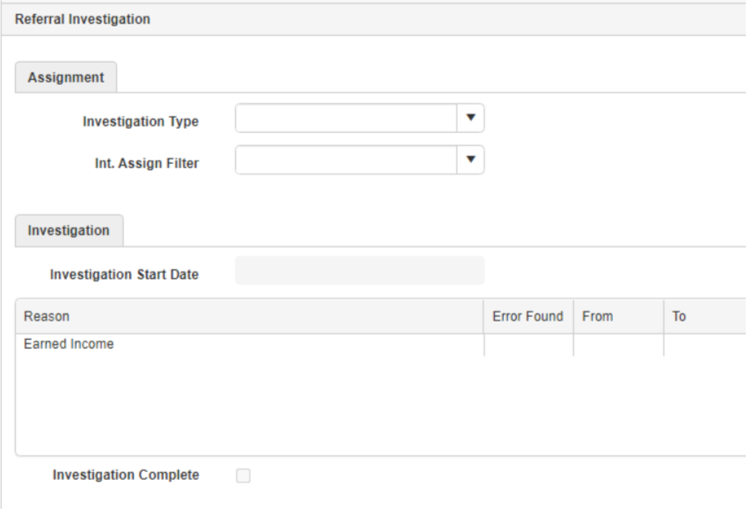
Overpayment Processing—BRITS cont’d
Counties each assign referrals and handle the investigation step differently. --If the referral has not already been assigned to you, in the Assignment section, fill in the Investigation type, Int. Assign Filter and assign it to yourself. --If it has not been already filled out, complete the Investigation section by entering the Investigation Start Date, updating the investigation findings section, and marking the Investigation Complete box.

Slide 44
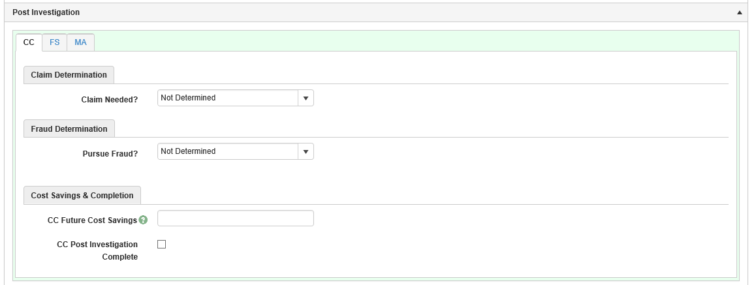
Overpayment Processing—BRITS cont’d
1. In the Post Investigation section, you will need to make entries for any pages that exist—FS/MA/CC. A W2 worker will close out their page. --If there is no claim needed, mark that there is no claim, no fraud, enter the appropriate cost savings, and mark the Post Investigation Complete box. Enter a comment to explain why there is no overpayment needed. --If you do not fill in all the entries, BRITS will not allow you to close out the referral.

Slide 45
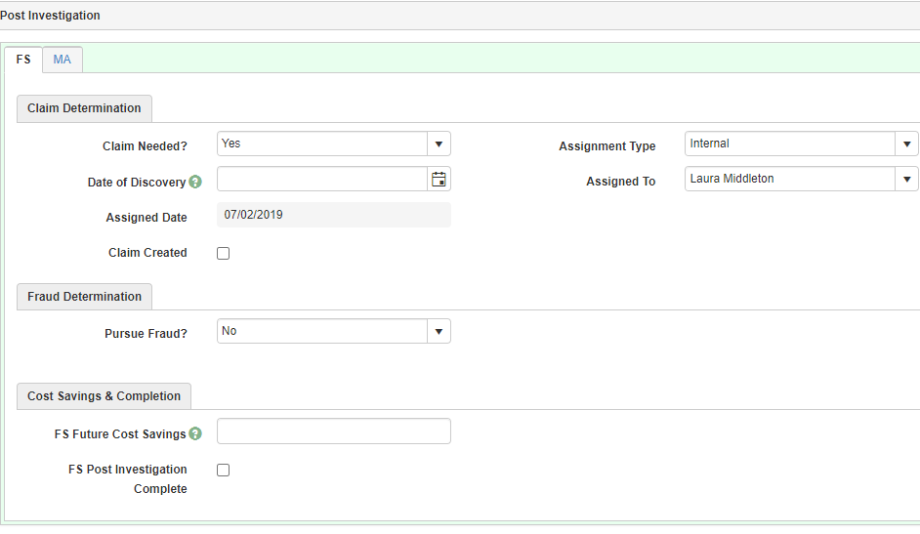
Overpayment Processing—BRITS Cont’d
2. Complete the necessary entries for Claim Needed, Date of Discovery (FS only), and the Assignment Type and Assigned To drop down boxes. Mark the claim complete box. 3. Complete the entries for Fraud Determination and Cost Savings. 4. Mark the Post Investigation Complete box.

Slide 46
Case Comments
It is best practice to enter case comments when you enter an overpayment.
Include the claim type and number, time period, and amount.
Document the reason the overpayment was entered. You can copy in the comments entered on BVRF.
BRITS requires that you enter the date of discovery for a FS referral. Remember, the date of discovery is the date the overpayment is being created.
There is no corresponding field for health care so workers will need to be generally aware and document in the case record the date on which they are creating the claim.

Slide 47
MA Overpayments
No Medical overpayments are being entered during the pandemic period—03/20—current, even if the member was never eligible or moved out of state.
A Medical overpayment is calculated, using actual income, as follows: If the case was ineligible for BadgerCare Plus, recover the total of fee-for-service claims paid by the state and any HMO capitation payments the state paid. Use ForwardHealth interChange data from the Total Benefits Paid by Medicaid Report(s). Deduct any amount paid in premiums for each month in which an overpayment occurred from the overpayment amount.
If the case is still eligible for BadgerCare Plus for the time frame in question but there was an increase in the premium, recover whichever is less of the following:
The difference between the premiums paid and the premium amount owed
The $ amount of claims and any HMO capitation payments the state paid for each month in question
When calculating the overpayment amount for premiums, the overpayment amount is the difference between the premium paid and premium owed, even if the premium that was paid was $0. Premium adjustments are only made on months where there is an overpayment. If there is a month in which there is no overpayment, then the premium calculation for that month should not be adjusted.
(Ref BC+ Handbook 28.4.2)
What this means:
Most BC+/MA overpayments are calculated using the Forward Health Total Benefits Paid screen. The agency is required to recover the Net Paid Medicaid and Net Capitation payments. These amounts are added together to determine the amount overpaid.
Net Paid Medicaid is the amount that the State paid out for services that the client actually received for prescriptions.
Net Capitation is the monthly HMO premium the State pays for the client to have the medical coverage each month.

Slide 48
MA Overpayment Tips
BC+/MA claims are calculated using the actual income. If no income verification is received, the average quarterly SWICA wages or other available data exchanges may be used. Document your actions in the overpayment comments.
If claim is for MA/BCP, you must send the manual notice and budgets to each liable individual.
It does not matter whether or not a customer ever used their medical card, they are still liable for the overpayment. This is because the State paid out an HMO premium for them to have the coverage.
Wait until all claims are processed before establishing a medical overpayment. A good rule of thumb is to wait 90 days to ensure all provider claims have been processed.
As of 2019, MAGA adults who moved to MAGM had no premiums to pay, regardless of their income changes. However, the children may have still owed a premium.
Once the public health emergency ends, agencies are expecting to be able to enter MA overpayments again.

Slide 49
MA IPVs
Form F-02913 will be used to obtain an MA IPV (though it will not be entered in CWW).
The benefit of this form is that you can recover an overpayment greater than the standard 12-month look back period. This form must be retained with the overpayment documents to substantiate why the claim is greater than 12-months.
The lookback period for health care overpayments, based on fraud convictions and a signed Intentional Health Care Program Violation Acknowledgement form, is 6 years. This also allows recovery of an overpayment less than $500.

Slide 50
How to Calculate an MA Overpayment Start in Forward Health

Slide 51
How to Calculate an MA Overpayment Find the Total Benefits Paid by Medicaid Report for each individual with an overpayment.

Slide 52
How to enter a foodshare ipv
Go to BVCI with SSN to find the claim number(s) pertaining to the FS IPV.
Go to BVCL with each of the FS claims the IPV goes with. Change the ‘Error Type’ to IV for each claim the IPV goes with.
In CWW, under Individual Non-Financial, go to the FS IPV sanction screen.
Enter the Intentional Program Violation Number (1, 2, or 3).
Enter the Type of Offense Code as “F1”.
Enter the Decision Date (the date the Waiver of ADH was signed or the date of the court decision).
On the bottom of the screen, check the box next to the FS claim(s) that go with this IPV. The error type must be Fraud to link the claim. Press Next.
Enter case comments, for example: Janet signed a Waiver of Administrative Disqualification Hearing form on 9/19/21 (scanned into ECF under SANC). FS IPV #1 keyed today eff. 11/1/21 for 12 mths. Goes with FS claim 0900387450.
The Sanction Duration in Months and Sanction Begin Date will auto populate once you enter off the screen.
See next page for example.

Slide 53
CWW foodshare IPV sanction page

Slide 54
Extensions to Existing Overpayment Timeframes
If there is a current claim referral in BRITS for a case, and continuation of the previously requested overpayment time period is needed, please enter BRITS comments with the new time period.
Request any additional verification needed for the extended timeframe.
For a Rock County case, email the overpayment team in Rock County at OverpaymentReferrals@co.rock.wi.us This is very important due to the new processing timelines.
Include in the email the case name, case number or BRITS referral number, date of the original BRITS referral and the extension time period.
EXAMPLE: Barney Rubble, BRITS# 1234567890, original referral date 3/13/19, additional time frame of OP 8/21-10/21

Slide 55
Questions?

