Slide 1
June 2022 Releases
June 24, 2022

Slide 2
Ops Memo 22-06 Verify Self-Reported Income Before Denying FoodShare Benefits
Effective July 1, 2022
Previously, self-reported income over the gross income limit for FS did not require verification
FNS has provided guidance that self-reported income is not adequate verification to deny or close a FS applicant or member for exceeding the income limit
Starting July 1, 2022, members will be asked to verify income that is over the income limit
Denial and termination notices will no longer reference income limit failures unless all income is verified and over the income limit

Slide 3
Ops Memo 22-07 Enhancements to Ethnicity and Race Identity Information Collection
Effective June 25, 2022
Applicants and members will be asked more detailed race and ethnicity questions
They will also be able to select more than one response to accurately report their race and ethnicity information
The intended use statement for ethnicity and race will be revised. This statement MUST be read to the customer prior to asking for ethnicity or race
Applicants and members are not required to provide responses for ethnicity or race to complete an application or receive a decision about program eligibility or benefits

Slide 4
Ops Memo 22-08 Reasonable Compatibility Threshold for Health Care
Effective July 1, 2022
Some healthcare programs use a reasonable compatibility test to determine if the applicant or member must verify their earned income. This determination is made by comparing the following two amounts:
The total income that includes the earned income reported by the data exchange
The total income that includes the earned income reported by the applicant or member
Under current policy, information from the data exchange is considered “reasonably compatible” if it results in the same eligibility outcome as the information reported by the applicant or member. No verification is required from the customer when this occurs.
DHS will temporarily add a 20% threshold to the reasonable compatibility test for income for healthcare
This threshold is expected to be in place until the completion of renewals for all members who have continuous health care coverage because of the COVID-19 public health emergency
The reasonable compatibility test using the 20% threshold will only be applied when the following two circumstances occur:
The total income that includes the earned income reported by the applicant or member is at or below the income limit
The total income that includes the earned income reported by the data exchange is above the income limit
In this situation, if the total income that includes the earned income reported by the data exchange is no more than 20% greater than the total income that includes the earned income reported by the applicant or member, the amounts will be determined to be reasonably compatible

Slide 5
Ops Memo 22-08 Reasonable Compatibility Threshold for Health Care
Example:
Walter is a childless adult applying for BC+. The monthly income limit is $1,132.50. Walter reports monthly earned income of $1,000; this is his only income, and it is below the income limit. The SWICA reports that Walter’s monthly earned income is $1,150. This income is above the income limit. Therefore, the reasonable compatibility test using the 20% threshold will be applied.
The 20% threshold amount is the amount that is 20% greater than the total income that includes the earned income reported by the application or member. In this example, the 20% threshold amount is $1,200. The total income that includes the earned income by SWICA ($1,500) is less than the 20% threshold amount ($1,200). Therefore, the amounts are determined to be reasonably compatible. Walter does not need to verify the earned income.

Slide 6
Ops Memo 22-08 Reasonable Compatibility Threshold for Health Care
With the addition of a 20% threshold, there are no changes in:
The programs that use a reasonable compatibility test for income
The income limits and premium thresholds that are subject to a reasonable compatibility test, and
The situations in which a reasonable compatibility test is used
The 20% reasonable compatibility threshold also will be applied to SWICA discrepancies. A SWICA discrepancy will not be created if an individual's income on file and quarterly SWICA information are found to be reasonably compatible using the 20% threshold
The 20% reasonable compatibility threshold will not be applied to the reasonable compatibility test used for assets for EBD Medicaid programs

Slide 7
Ops Memo 22-08 Reasonable Compatibility Threshold for Health Care
Members are not subject to overpayments for a given eligibility or premium determination in which their reported income was found reasonably compatible with a data exchange
Effective July 1, 2022, if a health care member is not required to verify their income due to reasonable compatibility and then verifies their earned income at a later date (for example, because verification is required for another program), the verified earnings should then be used to determine eligibility and premium amounts for health care
In this situation, members are not liable for overpayments because the initial determination was based on income that was reasonably compatible with a data exchange
If a healthcare member is not required to verify earned income due to reasonable compatibility and subsequently fails to report a required income change, the member can only be subject to an overpayment if their new income amount is more than 20% greater than the total income amount that was used to make the eligibility or premium determination

Slide 8
Ops Memo 22-09 Adjustments to FoodShare Temporary Absence Policy
Effective June 25, 2022
A FoodShare member is considered temporarily absent when they will be out of the home or food unit for an extended period of time, but will be returning to the food unit
There is no time limit on how long an individual can be temporarily absent
A member can be either staying in WI or in another state during the temporary absence
An individual’s temporary absence will be re-evaluated at renewal. Individuals will not be required to verify WI residency if they are claiming to be temporarily absent
Once an individual notifies the IM agency that they no longer reside in WI, they are no longer temporarily absent and are ineligible for FS
If another state considers the individual as eligible for SNAP benefits within that state, they are no longer considered temporarily absent and no longer a WI resident

Slide 9
Ops Memo 22-10 New Consolidated Notice and Oral Explanation of FoodShare Work Requirements
Starting on June 25, 2022, existing work requirement notices will be replaced with the consolidated FoodShare basic work rules and FoodShare work requirements notice which includes:
Which FoodShare basic work rules and FoodShare work requirements apply to each FoodShare member
Explanation of the FoodShare basic work rules and FoodShare work requirements and how to meet them
Current exemptions from FoodShare basic work rules and FoodShare work requirements
The notice will be automatically sent to FS units with ABAWDs or Work Registrants at the following intervals:
Application
Renewal
When a member’s work registrant or ABAWD status changes
*notices are not sent if no members are subject to either requirement

Slide 10
Ops Memo 22-10 New Consolidated Notice and Oral Explanation of FoodShare Work Requirements
Effective June 25, 2022, the new oral explanation of work requirements must be provided to all households with a member subject to a work requirement
Under the new oral explanation of FoodShare basic work rules and FoodShare work requirements policy, IM workers must identify which FoodShare unit member or members are subject to FoodShare basic work rules and FoodShare work requirements and provide the following information to the FoodShare unit as part of each FoodShare interview:
An explanation of each work rule and applicable work requirement.
Information on exemptions from each applicable work rule and work requirement.
An explanation of the process to request an exemption, including contact information to request an exemption.
What is required to maintain eligibility under each work rule and applicable work requirement.
Consequences for failure to comply with each work rule and applicable work requirement.
An explanation of the process for requesting good cause, including examples of good cause circumstances and contact information to initiate a good cause request
A new page in CWW: “FS Work Registrant/ABAWD Work Requirement Script Details” will be scheduled in the driver flow when the script needs to be read
*Note: The Work Registrant and ABAWD Reporting Script that IM workers currently read during the FoodShare interview will be obsolete beginning June 25, 2022. The FoodShare Reporting Requirements Call Script for Income Maintenance Agencies is not changing and will still be required

Slide 11
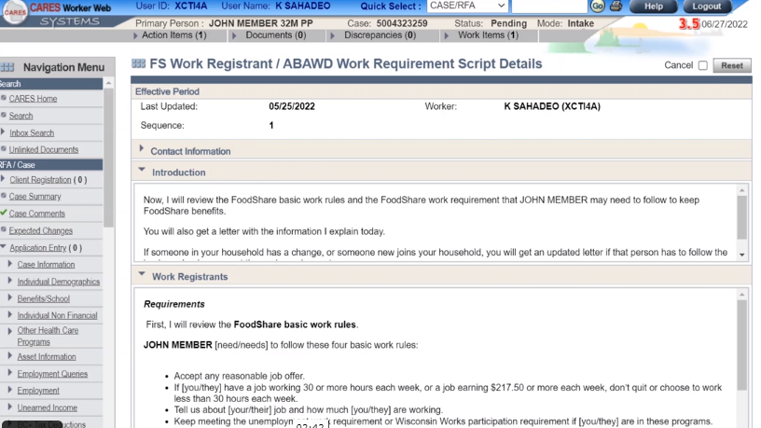

Slide 12
Ops Memo 22-11 New Fixed Three-Year FoodShare Clock and Other Changes
Effective June 25, 2022
FoodShare members between ages 18 and 49, who do not live with a child under 18 (also known as ABAWDs), and do not have a verified exemption, can only get FoodShare benefits for three months in three years unless they meet the FoodShare work requirement. These three months are referred to as countable months or time-limited benefits (TLBs). Under current policy, ABAWDs have a rolling 36-month clock with a begin date determined by when their first TLB month was accrued
Wisconsin DHS will transition from a rolling, individual 36-month clock to a fixed, state-wide three-year clock

Slide 13
Ops Memo 22-11 New Fixed Three-Year FoodShare Clock and Other Changes
Beginning on January 1, 2022, all FoodShare members aged 18 to 49 will have TLBs tracked using the same fixed FoodShare clock. CWW will be updated on June 25th to reflect this policy. All existing individual rolling FoodShare Clocks will be systematically ended as of December 2021
The new fixed FoodShare Clock began January 1, 2022, and ends December 31, 2024. All members eligible for FoodShare aged 18 to 49 are subject to the new FoodShare Clock. While all adult members will now have a FoodShare Clock, only those subject to the FoodShare work requirement during the three-year period may incur TLBs
The new fixed FoodShare Clock will establish the same three-year period for all FoodShare members regardless of the date the members were determined eligible or the date the members received their first TLB. A new three-year period will automatically start after each three-year period expires. When the next three-year period starts, FoodShare members with TLBs and additional months will have their countable months reset to zero. The next three-year period will begin on January 1, 2025
Example: Sally, aged 39, is an ABAWD and is determined eligible for FoodShare benefits on June 10, 2023. She does not meet her work requirement in July, August, or September of that year. Unless Sally verifies an exemption or begins meeting the work requirement, she will not be eligible for FoodShare benefits until the next three-year period begins on January 1, 2025

Slide 14
Ops Memo 22-11 New Fixed Three-Year FoodShare Clock and Other Changes
If an ABAWD uses all three TLBs within the three-year period, they will be ineligible to receive FoodShare benefits unless they reapply for FoodShare and meet the FoodShare work requirement or verify an exemption
FoodShare applicants must meet the FoodShare work requirement for 30 consecutive days prior to their new filing date to regain eligibility. The 30 consecutive days may now occur at any time after losing eligibility and prior to the ABAWDs new filing date, even if they are no longer working at the time they apply
ABAWDs can also regain eligibility by verifying they will meet the work requirement within 30 days after the new filing date. ABAWDs who do not meet the work requirement will remain ineligible for FoodShare until the start of the next three-year period
Example: Jose, aged 45, is an ABAWD and is determined eligible for FoodShare benefits on March 13, 2023. He does not meet his work requirement in April, May, or June of that year, exhausting all three of his TLBs. Jose is employed part-time (working 20 hours per week) on July 25 and reapplies for FoodShare benefits. Because Jose is now employed and is expected to meet his work requirement, he is determined eligible for FoodShare

Slide 15
Ops Memo 22-11 New Fixed Three-Year FoodShare Clock and Other Changes
Adult FoodShare applicants or members may have received TLBs or additional months while living in another state
These must be counted as TLBs and additional months in Wisconsin if they occurred during the current period of Wisconsin’s fixed three-year clock
Countable months must be verified if there is an indication that an adult applicant has received SNAP benefits in another state. However, verifying this information must not delay processing of the application or renewal beyond regular timeliness processing standards

Slide 16
Ops Memo 22-11 New Fixed Three-Year FoodShare Clock and Other Changes
Currently, the entire state of Wisconsin is considered an area of high unemployment through September 30, 2022
ABAWDs who live or lived in a geographic area where the FoodShare time limits are waived are not subject to TLBs
Starting June 25, 2022, CWW will now correctly classify these members as ABAWDs who are not subject to the time limit due to receiving an exemption for residing in these geographic areas

Slide 17
Additional Trainings in Cornerstone
Changes to ABAWD Policy and the FoodShare Clock
The Script Details Page and its Corresponding Notice
Demographic Details Micro Learning Video
Reasonable Compatibility 20% Threshold
*You can access these courses by selecting the Search feature under the Learning tab.

Slide 18
Questions?

