Slide 1
February CARES Release

Slide 2
Non-CARES Program Indicator
Process Help 11.3

Slide 3
Process Help 11.3.1.1
Testing Waiver Medicaid Eligibility for Members enrolled in an LTC program outside of CARES
Any member open for a full benefit Medicaid program (MAGA, MAPP, etc.) who meets a nursing home level of care can enroll in Family Care or Iris without requiring a Community Waiver page or Community Waiver programs in CWW
When individuals who are enrolled in a Long Term Care program in Forward Health are losing their Medicaid in CWW, worker’s must redetermine the member’s healthcare eligibility using the Community Waiver rules
New screens have been added to look up potential enrollment in LTC programs
A new 600 alert has been created that generates on the case to alert workers
A new chart has been added to Process Help to identify if we need to add a waiver screen.
The chart reflects receiving a referral from ADRC to initiate the process. Income Maintenance will not receive a referral if the case is already open for Full Benefit Medicaid. ADRCs send nothing to IM unless there has been a divestment per the state LTC process guide
Members and applicants should first be tested for regular program rules before looking at Waiver eligibility. Do not create a Community Waiver screen unless this is required for their program eligibility. Those eligible under regular program rules for Badger Care Plus, MAPP, etc, do not require Waiver to enroll in Family Care or Iris

Slide 4
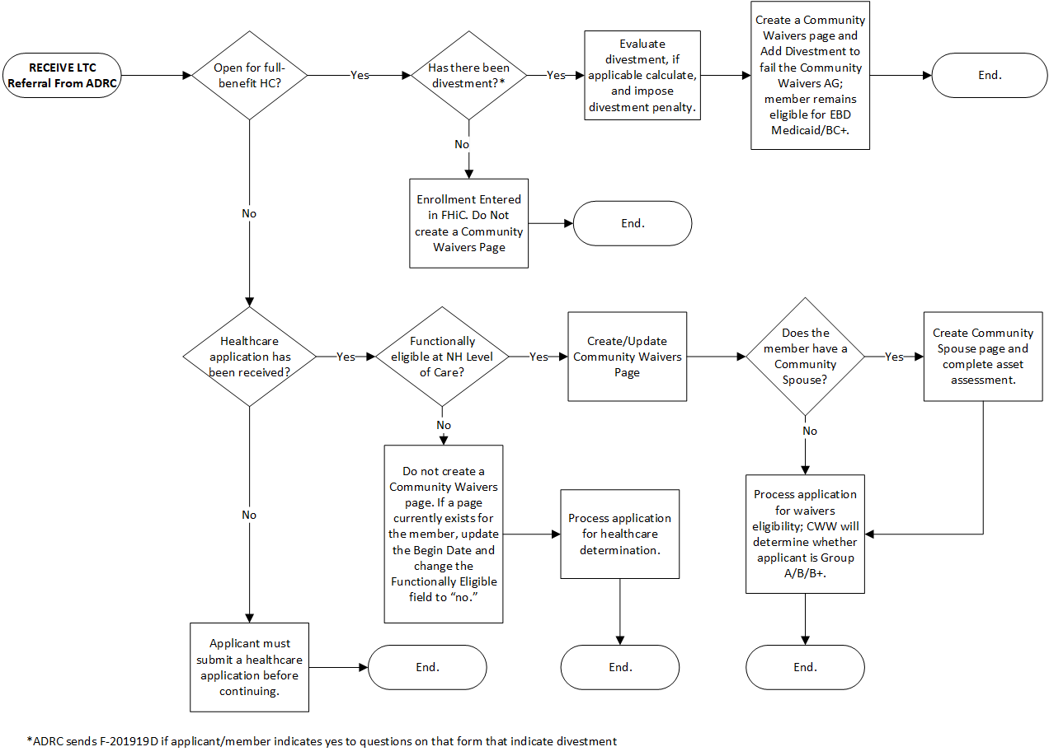
LTC Process Chart

Slide 5
Alert 600
When an individual loses their primary MA source and is enrolled in Family Care or IRIS in Forward Health, Alert 600 will generate with the name of the individual we need to review eligibility for.
When receiving the 600 alert, query the case or individual to check enrollment in LTC programs.
Determine if/when there will be a loss of Medicaid.
If they have a renewal due, simply comment there has been no loss of Medicaid and a renewal is due XX/2022. Clear the alert
If they are losing Medicaid for other reasons, review the case to determine the appropriate course of action.

Slide 6
Alert 600 - Adults
When an adult is losing their Medicaid in CWW and is enrolled in a Long Term Care program in Forward Health:
When receiving the 600 alert, query the case or individual to check enrollment in LTC programs.
If they are over 18 and younger than 65 years of age and are losing eligibility for Badger Care Plus:
Review disability status on the case.
If they have a disability determination, the case will need to be reviewed and tested for EBD program eligibility. Transfer to the LTC team. Do not delete the alert on the case so the team will know the case needs review.
If there is no disability determination, mail the ADDMD, ADDD, and MADA to the client with a free format letter.
Once received in the LTC team:
Review the case and pend for any assets necessary for determination.
Initiate an AVS request on the case.
Test for EBD program eligibility
Build a Community Waiver page if appropriate.
Apply any spousal impoverishment applicable
Confirm or deny benefits as appropriate

Slide 7
Alert 600 - Children
When a child is losing their Medicaid in CWW and is enrolled in a Long Term Care program in Forward Health:
When receiving the 600 alert, query the case or individual to check enrollment in LTC programs.
If the child is losing their Medicaid and should be tested for Children’s Waiver:
Transfer to the LTC team. Do not delete the alert on the case so the team will know the case needs review.
Once received in the LTC team:
Review the case
Email the CLTS services in your local office to request the appropriate documents to open Children’s Waiver
CLTS Waiver form
Medicaid Cost Sharing Worksheet
Complete any workarounds necessary under CLTS processing to open the case for Children’s Waiver
Build a Community Waiver page.
Confirm Children’s Waiver open

Slide 8
Process at a Glance – Adults
BCP Cases
Review the case to determine why the individual is losing MA
If they are losing MA due to needing a renewal, comment this and delete the alert
Adults w/o a disability
If they are losing BCP due income or other reasons, review for disability status.
If they do not have a disability, send all paperwork for establishing a disability.
Adults with a disability
If they are losing BCP due to income or other reasons, review for disability status.
If they have a disability, test for regular EBD MA programs, including pending for assets.
Comment actions taken and that they are ineligible for other programs due to no disability determination
If they are eligible under regular EBD program rules, confirm the case.
Testing for Waiver
If an adult fails for all programs and needs to be tested for Community Waiver, case comment that Waiver eligibility need to be reviewed
Transfer to the LTC team
Email the team to follow up on the case

Slide 9
Process at a Glance – Adults – LTC Staff
LTC Review
Review the case to determine why the individual is losing MA
Testing for Waiver Eligibility
Email dhsltcfsteam@dhs.Wisconsin.gov or the Managed Care agency to obtain the functional screen.
Create a community waiver screen and complete for the appropriate program
Determine if Community Waiver is needed
Check marital status
Apply any spousal impoverishment rules
Complete asset assessment as appropriate
Request assets and initiate an AVS request
Confirm or deny Community Waiver eligibility based on information received

Slide 10
Process at a Glance – Children
Case Review
Review the case to determine why the individual is losing MA
If they are losing MA due to needing a renewal, comment this and delete the alert
Children
If they are losing BCP due income or other reasons, transfer to the LTC team.
Testing Waiver Eligibility
Review the case
Email the team to follow up on the case
Email the CLTS department to request paperwork
Once the Medicaid Cost Sharing worksheet and referral is received, build the Waiver screen and test for Children’s Waiver
Use the workarounds to open Children’s Waiver as appropriate

Slide 11
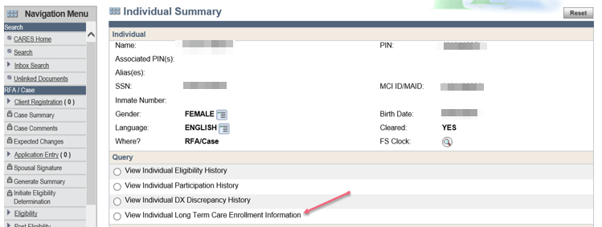
Searching by PIN or SSN
Workers can search by PIN or SSN to find the enrollment information for an individual in CWW

Slide 12
Searching by PIN or SSN
A screen will display that shows the program they are eligible for and the enrollment date.

Slide 13
Case Search
Under Query, there is a new link: Member’s LTC Enrollment Information

Slide 14
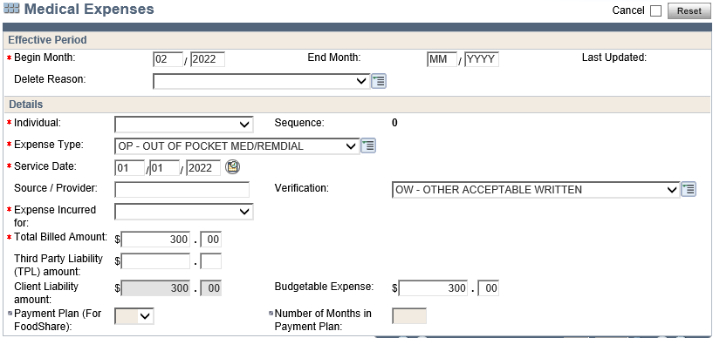
Process Help 11.3.7.2
Community Waiver Med/Remedials
Income maintenance receives med/remedial expenses for members from the ADRC, Managed Care Organization, or IRIS consultant
They are required to verify all expenses and reviews to ensure they are eligible expenses.
They provide the total amount and the IM worker enters this into the case under OP – Med/Remedial Expense

Slide 15
Veteran’s Benefits
Process Help 3.11

Slide 16
Process Help 3.11
A new area has been added on the Unearned Income page for Aid & Attendance amounts to be entered
The field under disregards, expenses, and losses states:
Does the VE benefits include any Aid & Attendance, Housebound, and/or Unusual Medical Expenses?
The response field is entered as Yes, unknown, failed to provide, or No.

Slide 17
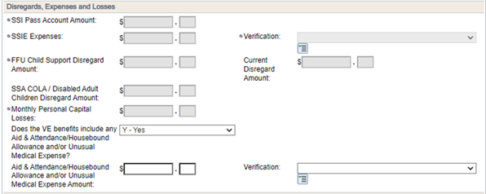
Process Help 3.11

Slide 18
Process Help 3.11
If the worker selects unknown, a notice generates requesting more information about the benefit.
Selecting Yes, enables the field to enter an amount and the verification code
Selecting No, the field remains disabled.
Selecting Failed to provide or entering QV/NV in the verification field, will count the full amount

Slide 19
Processing Moves
Process Help 3.19.12

Slide 20
Process Help 3.19.12
When a suspended member moves from one facility to another, special processing is needed.
A release date must be entered on the page

Slide 21
Process Help 3.19.12
Next, enter the new facility and start date of the incarceration period

Slide 22
Other Changes/Updates

Slide 23
The vehicle pages now allow up to 20 vehicles (PH 17.1.1)
New phone number for Fiscal Agents – 608-684-0362 (PH 11.6.9)
Asset Assessments
New process steps in Process Help 11.5.2.1
New functionality allows new asset transfer period when person is re-institutionalized and qualifies.
Real Property – PH 11.10.1.2 – Tips and screenshot for completing the real property page and gives codes to use.

