Slide 1
Administrative Disqualification Hearings and the Fraud Process
07/14/22

Slide 2
Table of Contents
2 FSH 3.14.1 IPV Disqualification
3 FSH 3.14.1.1 Period of Ineligibility
4 FSH 3.14.1.2 IPV for Duplicate Issuance
5 Status of Overpayments and Fraud (2022)
6—7 Pre-Charge Diversion
8—13 ADH Process
14 How do I prove intent?
15 Closing Thoughts

Slide 3
FoodShare Handbook 3.14.1 Intentional Program Violation (IPV) Disqualification
An applicant or member commits an Intentional Program Violation (IPV) when he or she intentionally:
Makes a false or misleading statement or misrepresents, conceals, or withholds facts, including but not limited to their identity, who he or she is living with, or which state they live in, to become eligible or to remain eligible for benefits; or
Commits any act that constitutes a violation of the Food and Nutrition Act of 2008, the Supplemental Nutrition Assistance Program Regulations, or any Wisconsin statute for the purpose of using, presenting, transferring, acquiring, receiving, possessing, or trafficking of FoodShare benefits or QUEST cards.
An IPV may be determined by the following means:
Federal, state, or local court order
Administrative Disqualification Hearing (ADH) decision
Pre-charge or pretrial diversion agreement initiated by a local district attorney and signed by the FoodShare member in accordance with federal requirements
A signed and completed “Waiver of Administrative Disqualification Hearing” form (F-16039)

Slide 4
FoodShare Handbook 3.14.1.1 Period of Ineligibility
SANCTIONS
One year for the first IPV.
Two years for:
The second IPV or,
The first IPV for which an individual is convicted in a federal, state, or local court to have used or received benefits in a transaction involving the sale of drugs of less than $500.
Permanently for:
A third IPV, or
A first IPV resulting from the conviction of the individual by a federal, state, or local court for having used or received benefits in a transaction involving the sale of firearms, ammunition, or explosives, or
A first IPV resulting from a conviction of an individual in a federal, state, or local court involving trafficking benefits for an aggregate amount of $500 or more, or
A second IPV for which an individual is convicted in a federal, state, or local court to have used or received benefits in a transaction involving the sale of drugs.

Slide 5
FoodShare Handbook 3.14.1.2 IPV Disqualification for Receipt of SNAP Benefits from Multiple States
A person who makes a false or misleading statement, or misrepresents, conceals or withholds facts with respect to their identity or place of residence in order to simultaneously receive Wisconsin FoodShare benefits and SNAP benefits from any other state shall be ineligible for a period of 10 years.
Before imposing the 10-year disqualification period:
A finding of fraud must be made by a state agency, or
A conviction of fraud must be entered by a state or federal court.
The administrative disqualification hearing process, including the offer to sign the Waiver of Administrative Disqualification Hearing (F-16039), may be used for imposing this penalty.

Slide 6
Status of Overpayments and Fraud NOW (2022)
Presently (07/22), Agencies are not to be entering agency or client error FS/MA overpayments.
Further, the State has terminated all the FS/MA overpayments entered during the pandemic time period—for dates within the pandemic time period—unless they are being pursued for fraud.
At this point in time, we are not able to enter new FS/MA overpayments, including those for a fraud case, until we obtain an IPV through court, pre-charge diversion hearings, or ADH (Administrative Disqualification Hearings).
In Rock County, we are referring Fraud cases with overpayments over $3,500.00 to the District Attorney’s Office to start the Pre-Charge Diversion process. Cases with overpayments less than $3,500.00 are being sent through the ADH process.

Slide 7
FRAUD PROCESS
Once a case is accepted for FRAUD, the Overpayment Worker/Team will determine the time period for the overpayment as well as how much the overpayment amount will be…which will then determine which path the case will follow.
Referral to DA for Pre-Charge Diversion (Rock County process)
For cases with overpayments in excess of $3,500.00.
The Fraud packet, with all related forms and Overpayment Worksheets, is routed to the DA’s office.
The DA’s office sends out letters 14-30 days prior to the meeting date advising the client that they have been invited to attend this conference in lieu of going to court.
Since the letter is mailed from the DA’s Office, there is not a copy in ECF.
At the meeting, the client is presented with their case and is given the option to sign the Disqualification Consent Agreement or to proceed with the court route by having a warrant issued.
If the client does not appear for the meeting, the DA will either send a 2nd of 3rd Letter or will issue a warrant to start the court process.

Slide 8
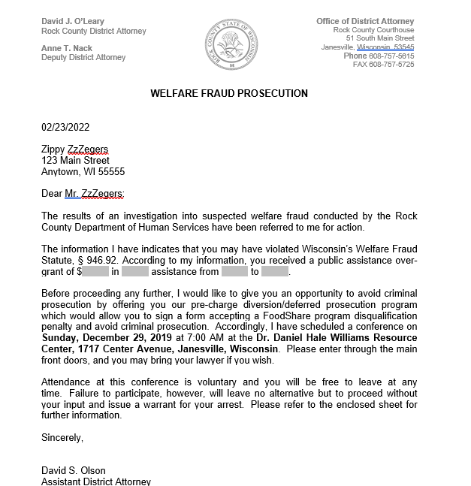
Copy of the initial letter sent for Pre-Charge Diversion.

Slide 9
ADH Process At a Glance
When requesting an Administrative Disqualification Hearing (ADH), there must be clear and convincing evidence demonstrating that the individual committed, and/or intended to commit, an Intentional Program Violation (IPV).
The burden of proof is on the local agency to prove the actions were intentional and provide verification that the member’s reporting requirements were understood.
Once all paperwork that will be needed to prove the case has been gathered, and the overpayment amount has been determined, Agency will mail the client a Waiver of Administrative Disqualification Hearing form with a 2-week due date. (Form F-16039)
If the client signs and returns the form, the overpayment and IPV can be entered. A copy of the signed form should be mailed to the client for their records.
If no waiver is received, the worker must start the ADH process.
In Rock County, this is used for cases where the overpayment will be less than $3,500.00.

Slide 10
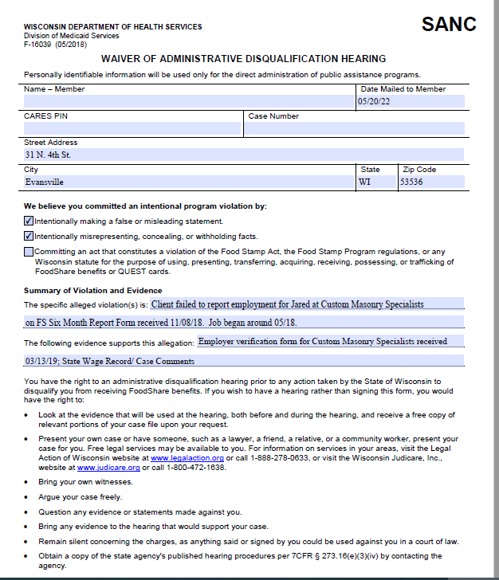
Waiver of ADH Form (F-16039), Page 1
Key Points:
Form should be mailed to the current address listed in CWW, as well as any other address that may be found in CLEAR, FEV investigation, or other reports.
Be specific about the alleged violation and evidence.

Slide 11
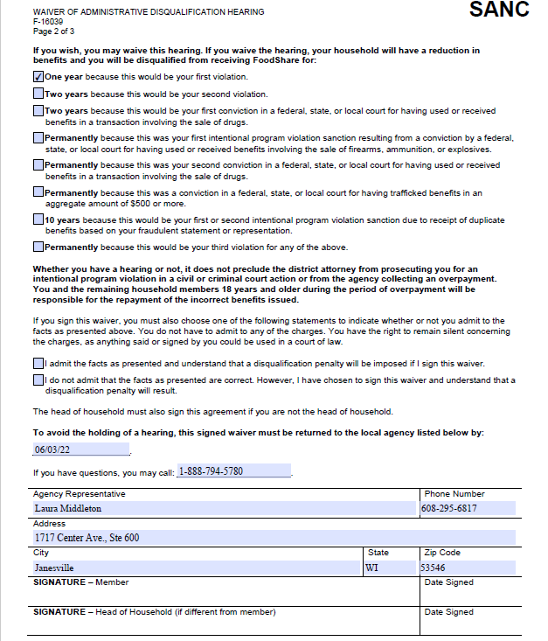
Waiver of ADH Form (F-16039), Page 2
Key Points:
Indicate the appropriate sanction disqualification period.
Highlight the checkboxes, due date, and Member Signature sections.
One box must be checked for the form to be valid.

Slide 12
ADH Process, continued
An ADH Hearing is like a Fair Hearing, in that it is a hearing conducted by the Division of Hearings and Appeals, but in this case, the Agency is asking for the finding of an IPV.
The Agency must prove that the IPV occurred, showing clear and convincing evidence.
If the client fails to appear, the Agency must still present its case and evidence, and be prepared to answer any questions from the ALJ.
All tracking is done by the Agency—meaning that the Agency is responsible for notifying the client of the hearing and manually sending in any evidence materials to the client and the ALJ (unable to use the FH Tracker).
Each Agency has their own format for sending out the Waivers and Hearing Notices, but the forms are the same.

Slide 13
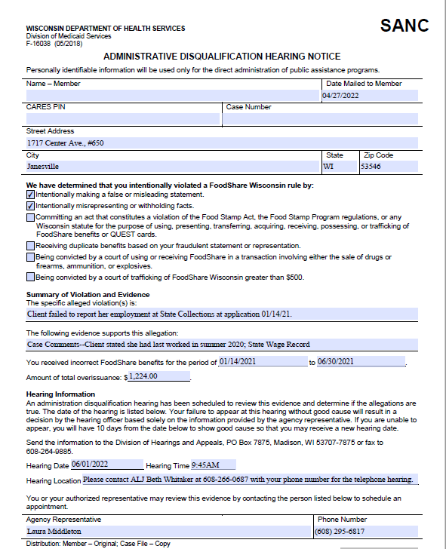
ADH Hearing Notice
(Form F-16038), Page 1
Key Points:
Form should be mailed to the current address listed in CWW, as well as any other address that may be found in CLEAR, FEV investigation, or other reports.
Be concise but specific about the alleged violation and evidence.
List the overpayment time frame and amount.
Highlight the Hearing Date, Time, and Location.
Advise the client to contact the ALJ with their phone number for the hearing.
Form must be mailed to the client at least 30 days before the scheduled hearing date.

Slide 14
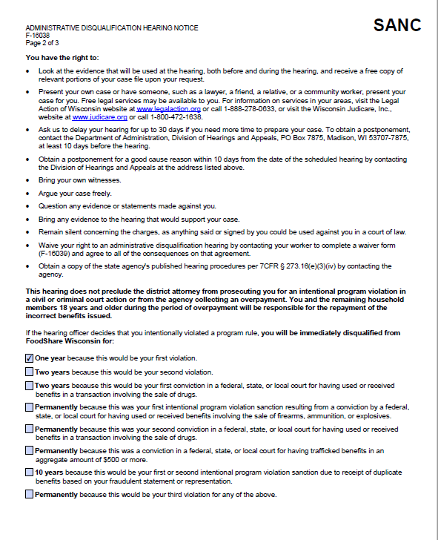
ADH Hearing Notice
(Form F-16038), Part 2
Key Points
Indicate the appropriate sanction disqualification period.
The client has the right to sign the ADH Waiver form to avoid this hearing—even after they failed to sign it prior to receiving this form.

Slide 15
How do I prove intent???
To prove intent, you must have clear and convincing evidence that demonstrates that the FoodShare recipient knew that the act or omission was a violation of the FS program but committed the violation anyway.
Evidence used to prove intent includes, but is not limited to:
Notices
Applications/SMRFs/Renewals
Leases/Historic Wage Verification Forms/Written Statements
Case Summary mailed after application or renewal
Case Comments
EBT Edge for WI usage history
CSI Investigation reports
Other state FS benefit history
Other state EBT usage history

Slide 16
Closing Thoughts
While we are unable to enter standard overpayments at this time, you should still refer a case for overpayment/fraud if you find clear intent—client provided false information at application/renewal or client was open for benefits in another state but claimed to be living in WI.
If a client made multiple contacts with the Agency and failed to report their change, but there was no renewal or application, it may still be possible to pursue as a fraud in some instances. Case comments are the key:
Worker confirmed name, address, and household comp
Worker questioned client regarding how expenses are being met with no employment

Slide 17
Questions?

